Slide 1
Site Navigation
For New GBE web page
Circa July 2013, using old colors

Slide 2
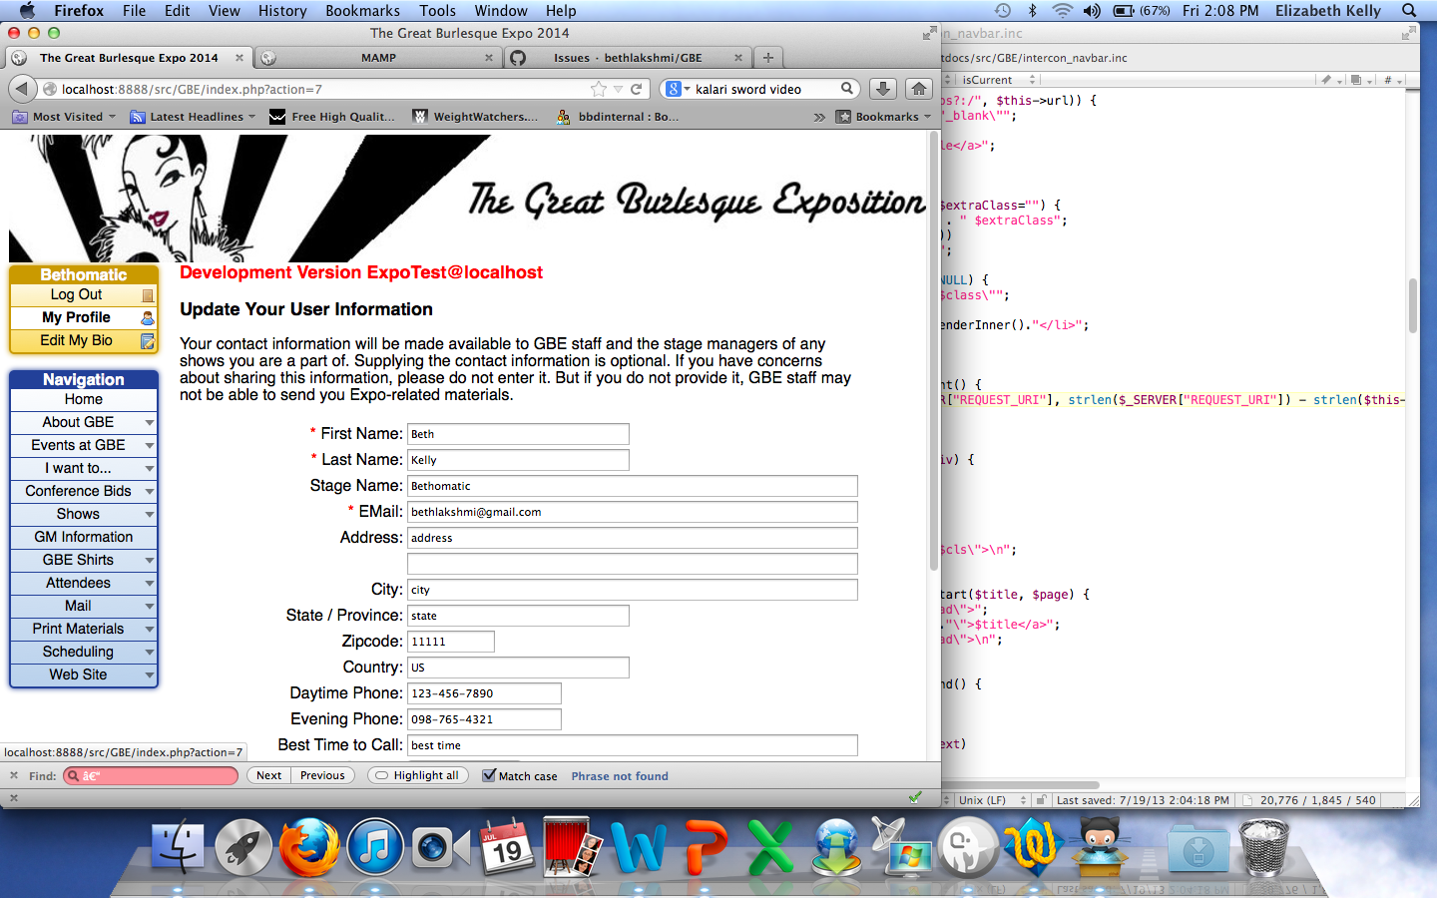
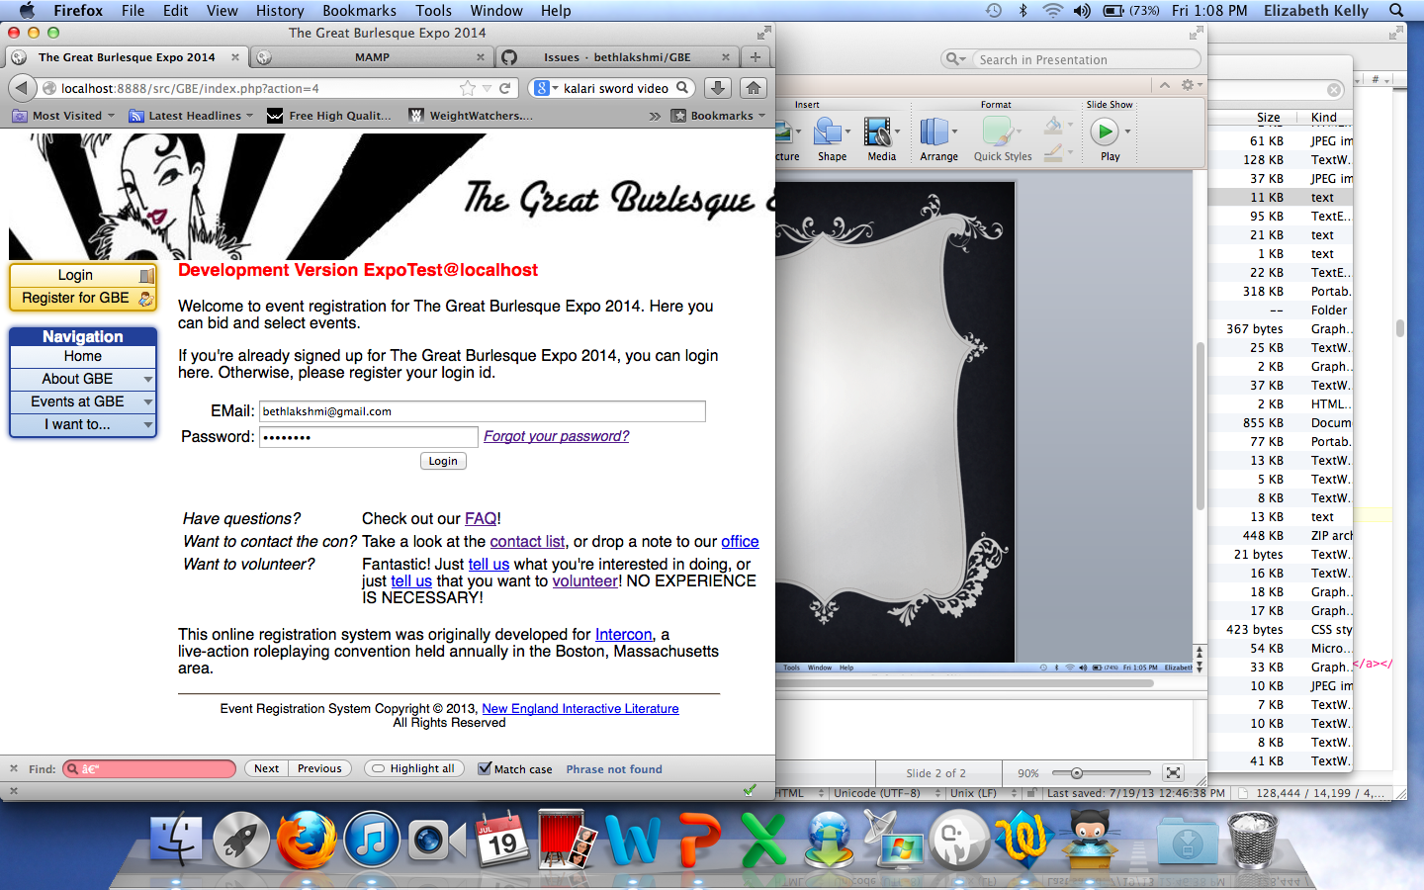
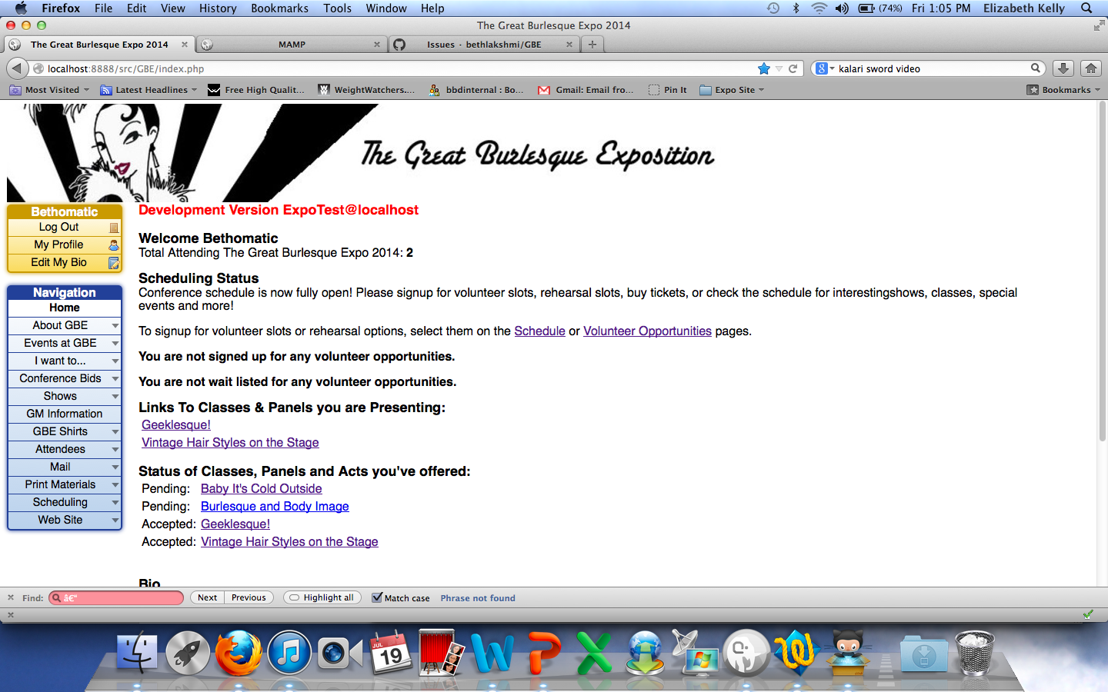
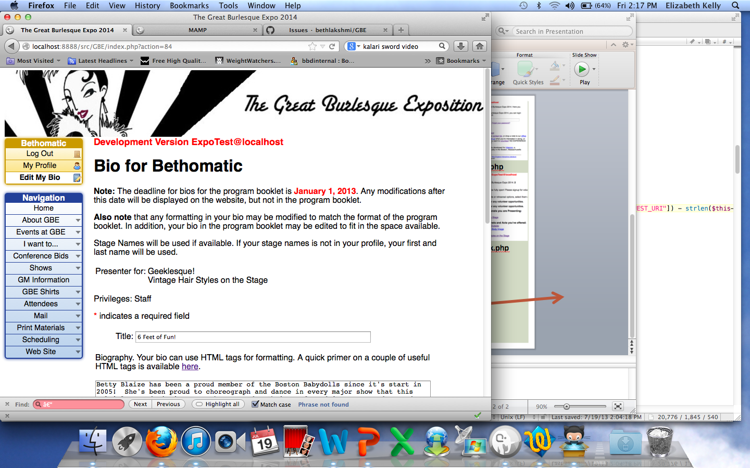
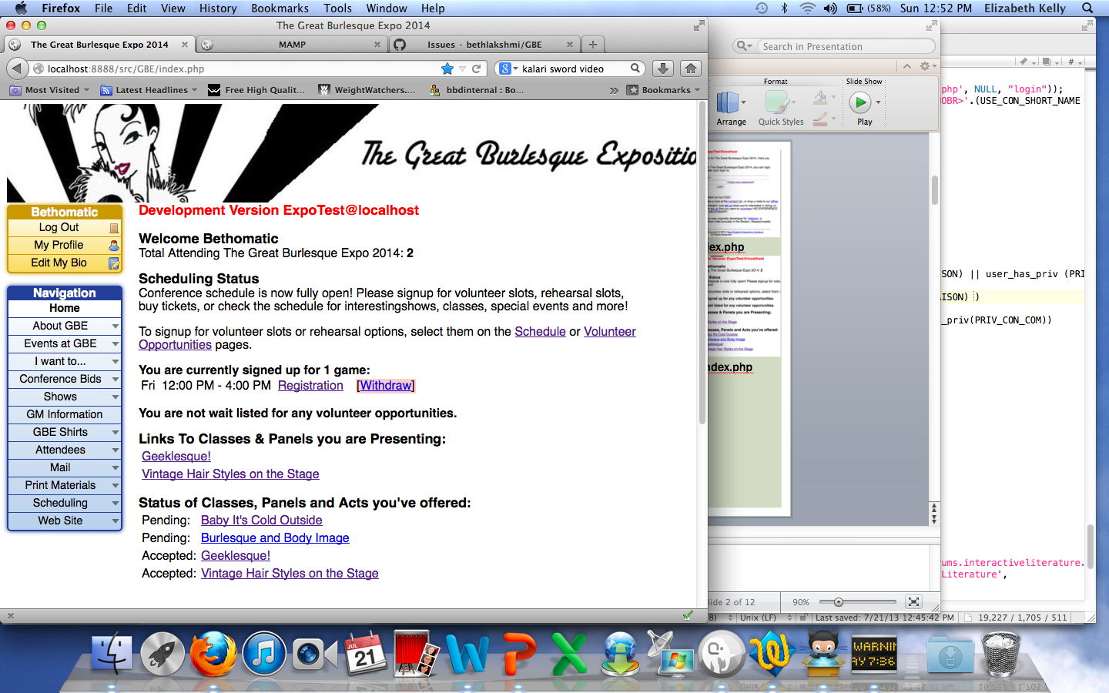
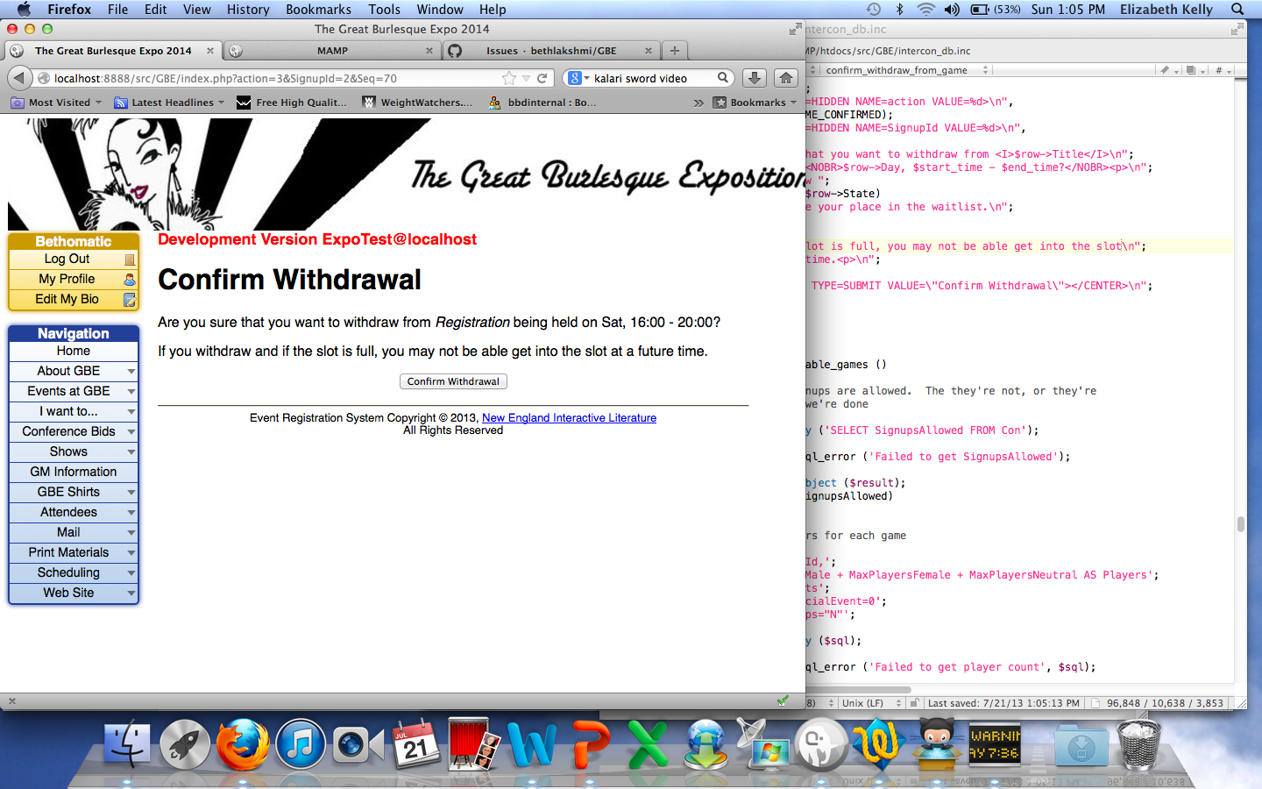
index.php?action=7
index.php
Schedule.php?action=25&EventId=<int>
index.php
Bids.php?action=5
0&BidId=<int>
index.php?action=3&SignupId=<int>&Seq=48

Slide 3
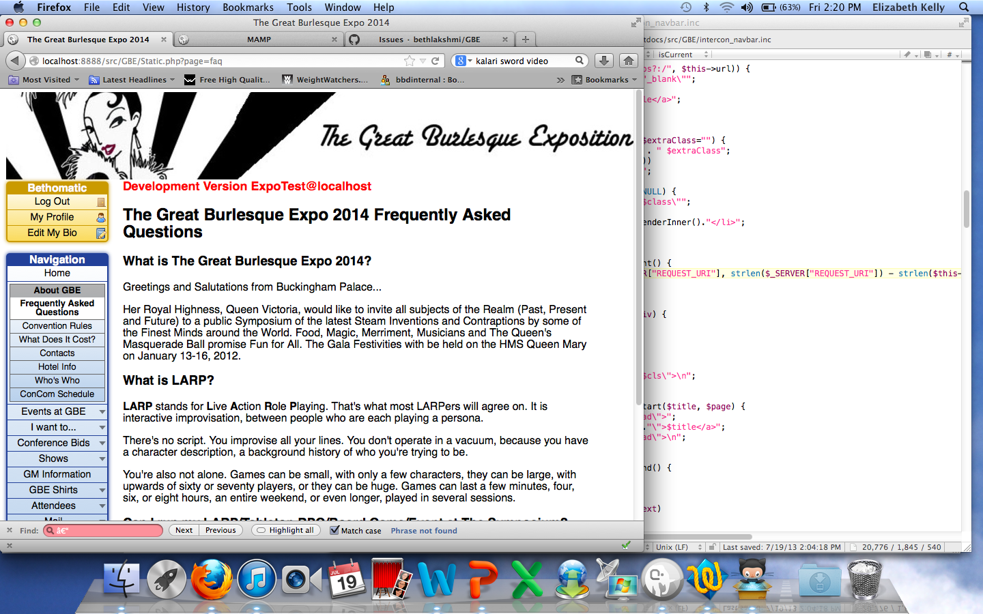
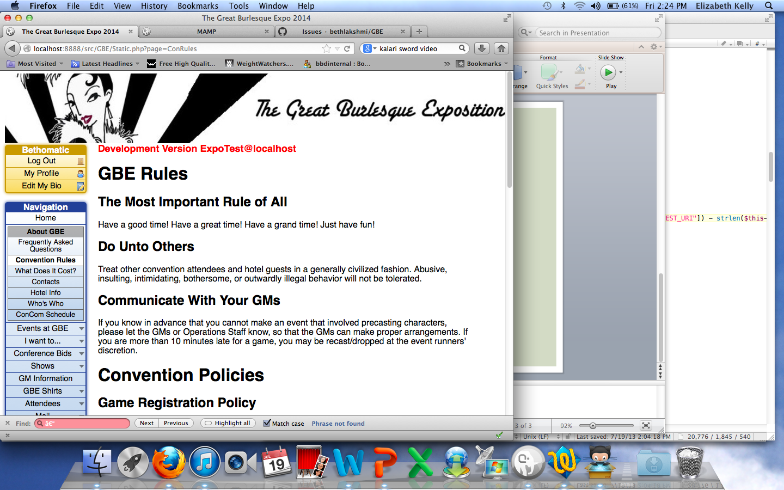
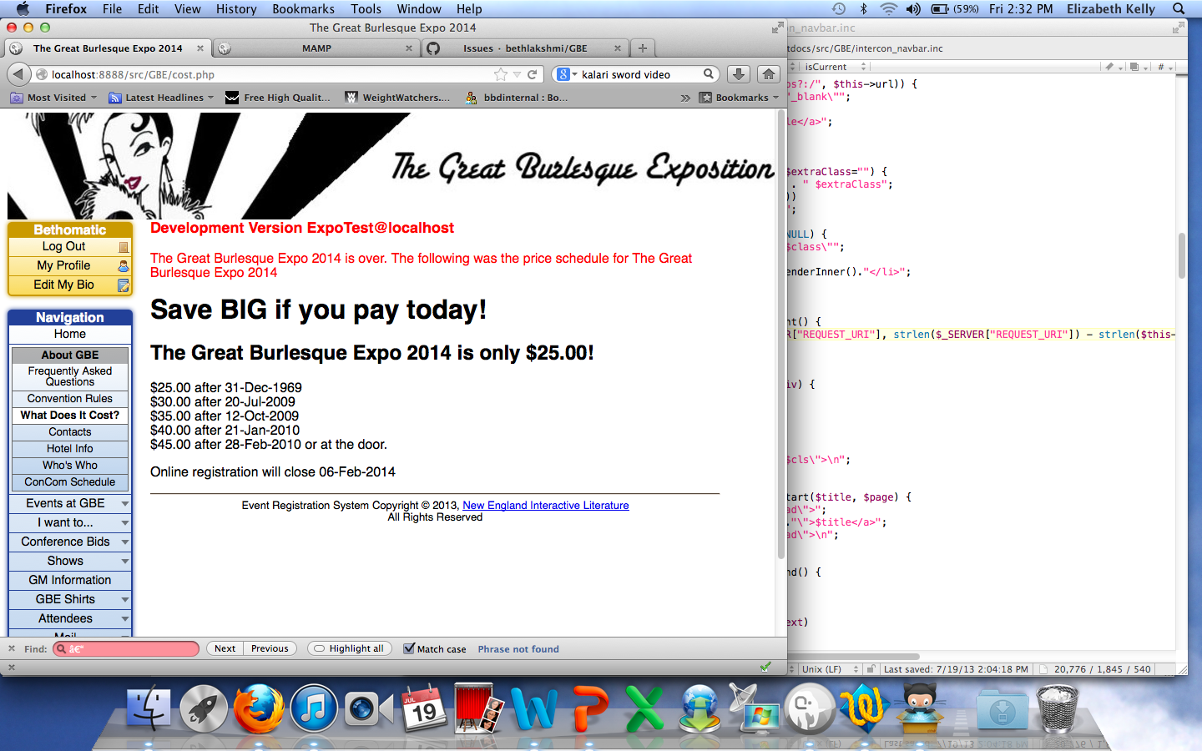
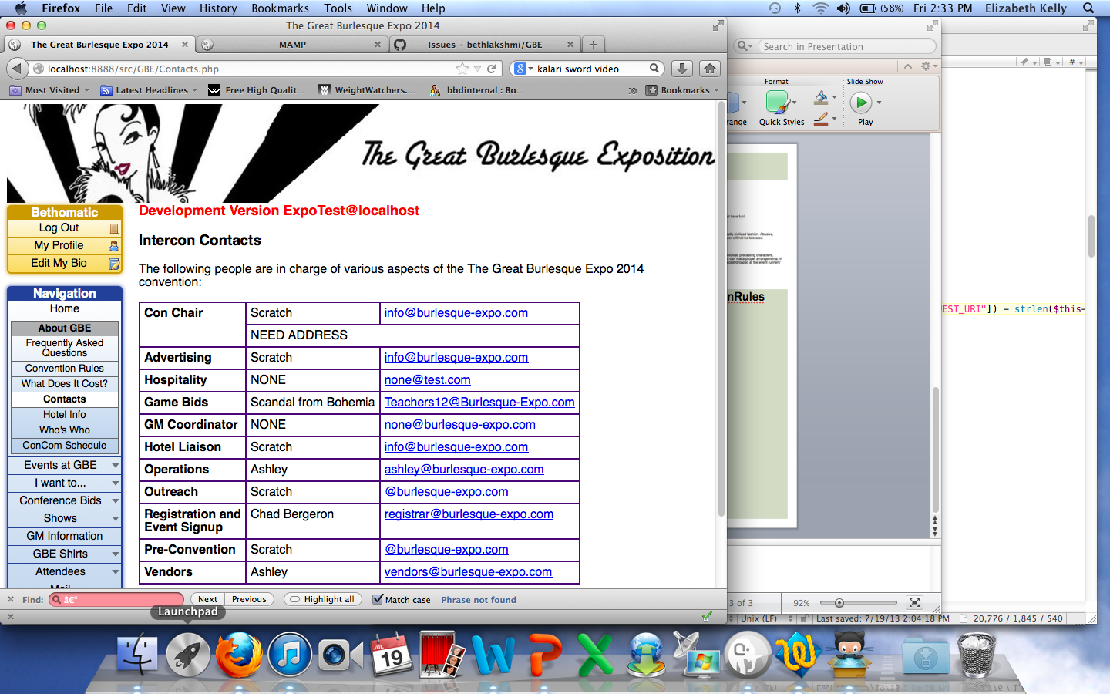
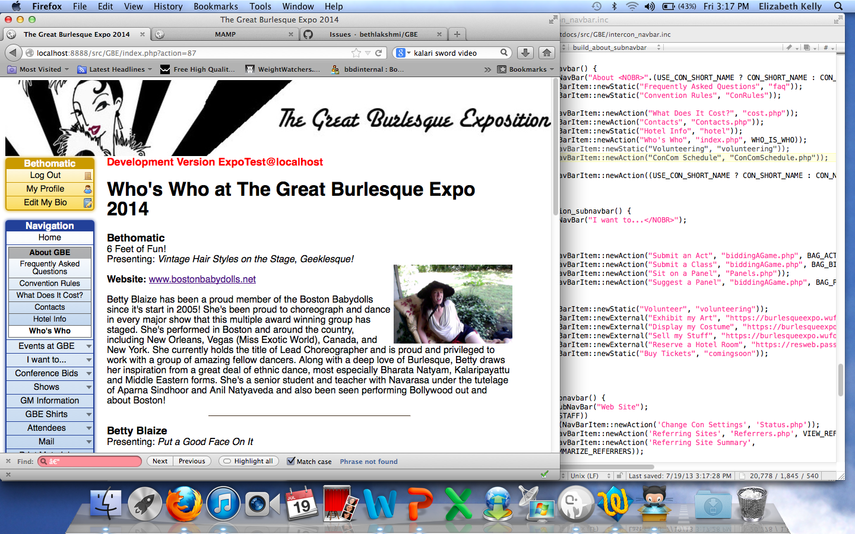
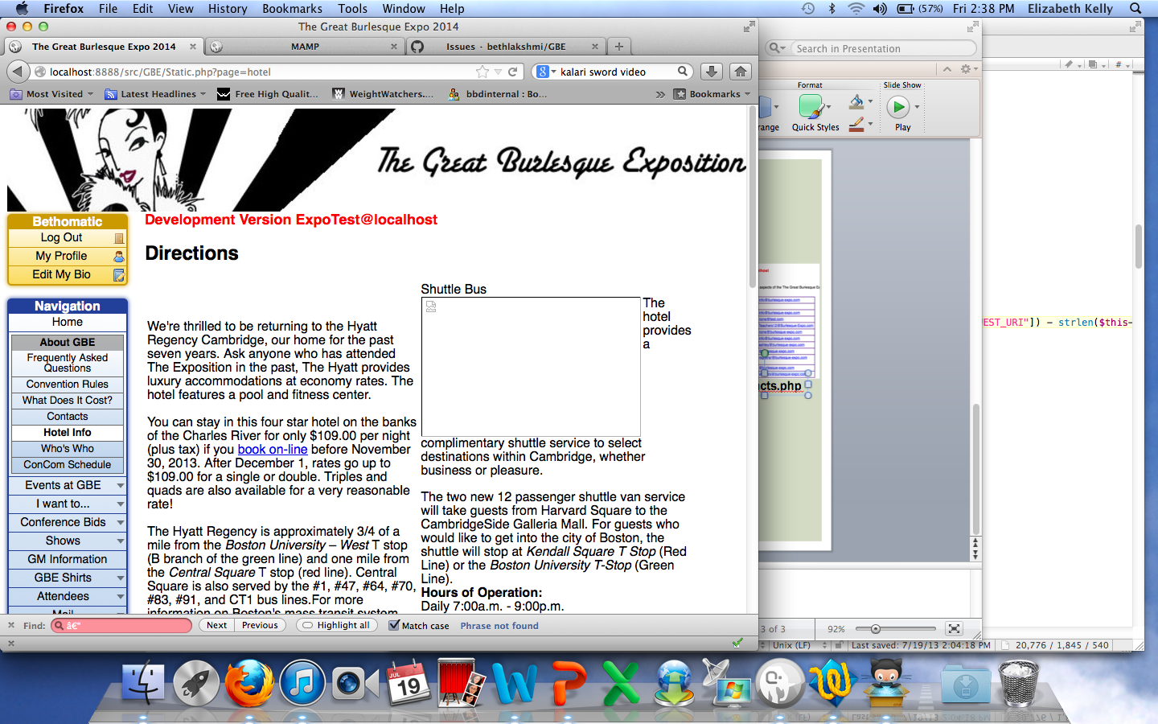
* ConCom Schedule has been removed since photos
Static.php?page=faq
Static.php?page=ConRules
cost.php
Contacts.php
Static.php?page=hotel
index.php?action=87

Slide 4
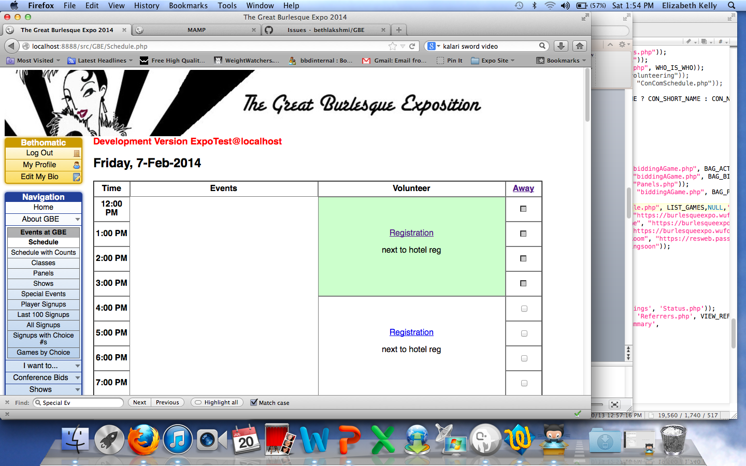
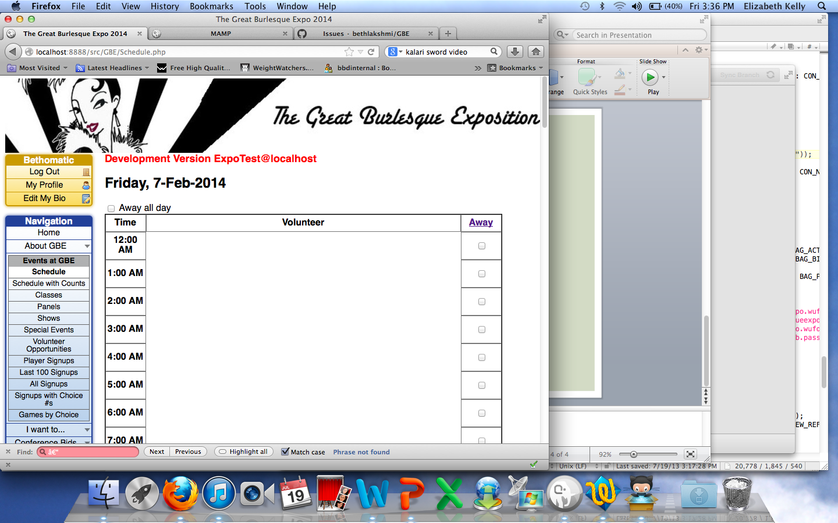
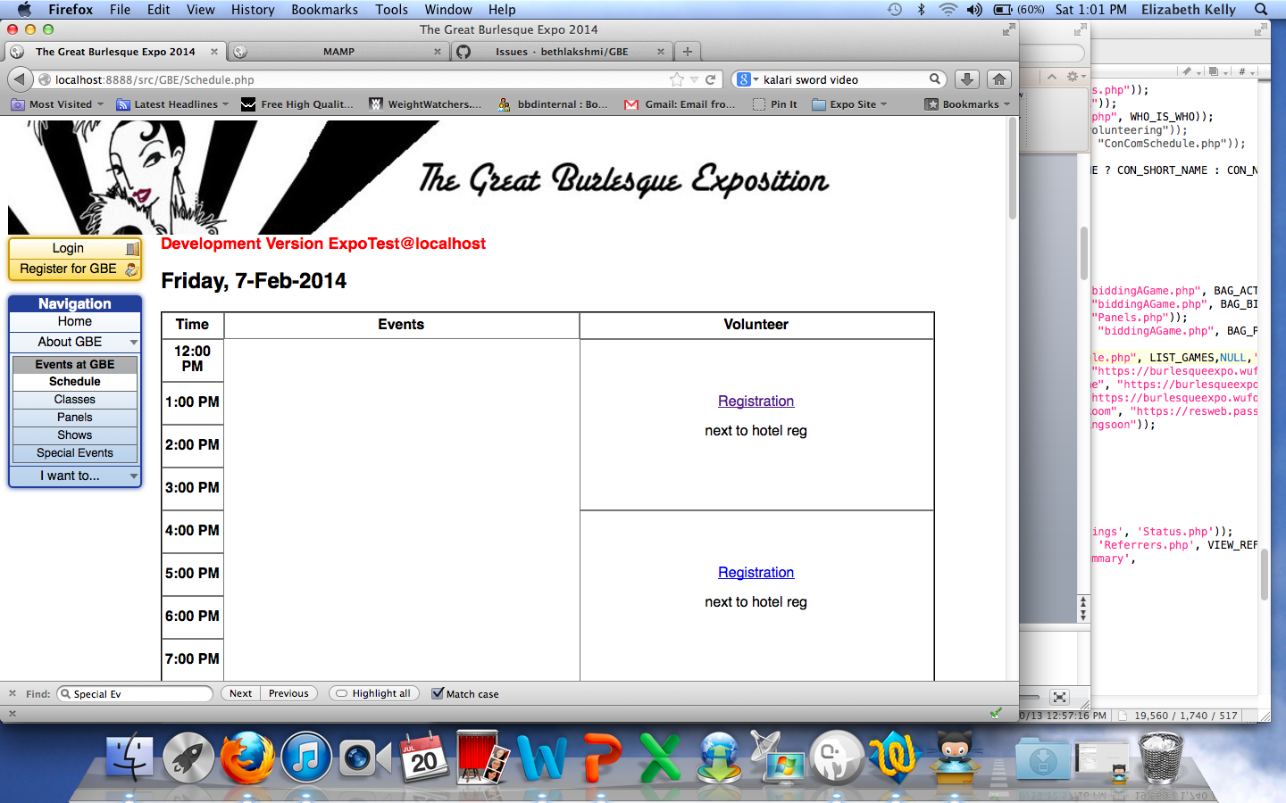
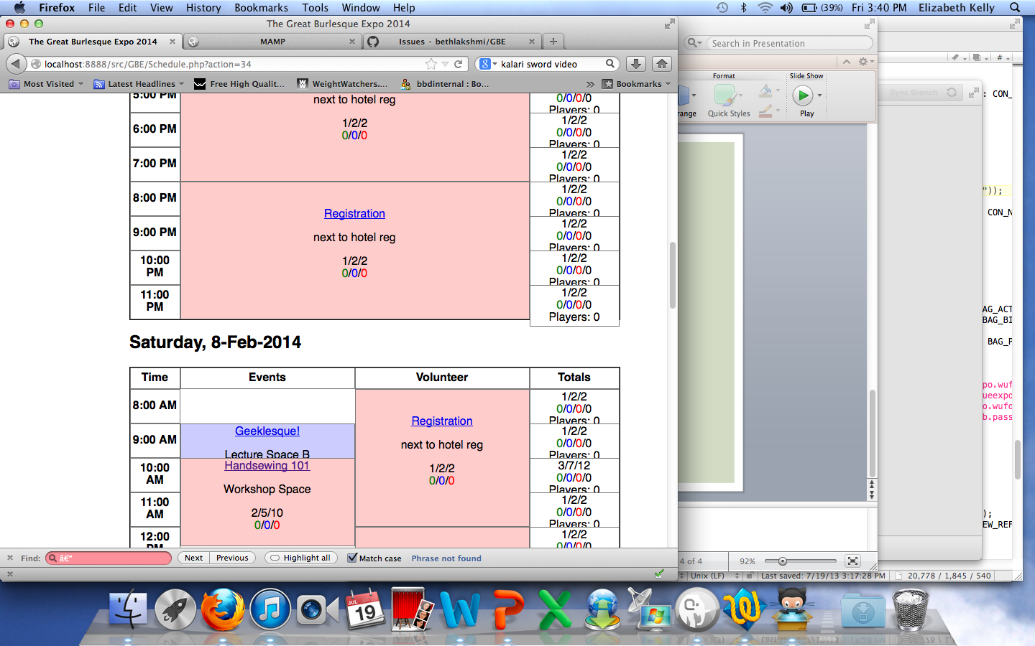
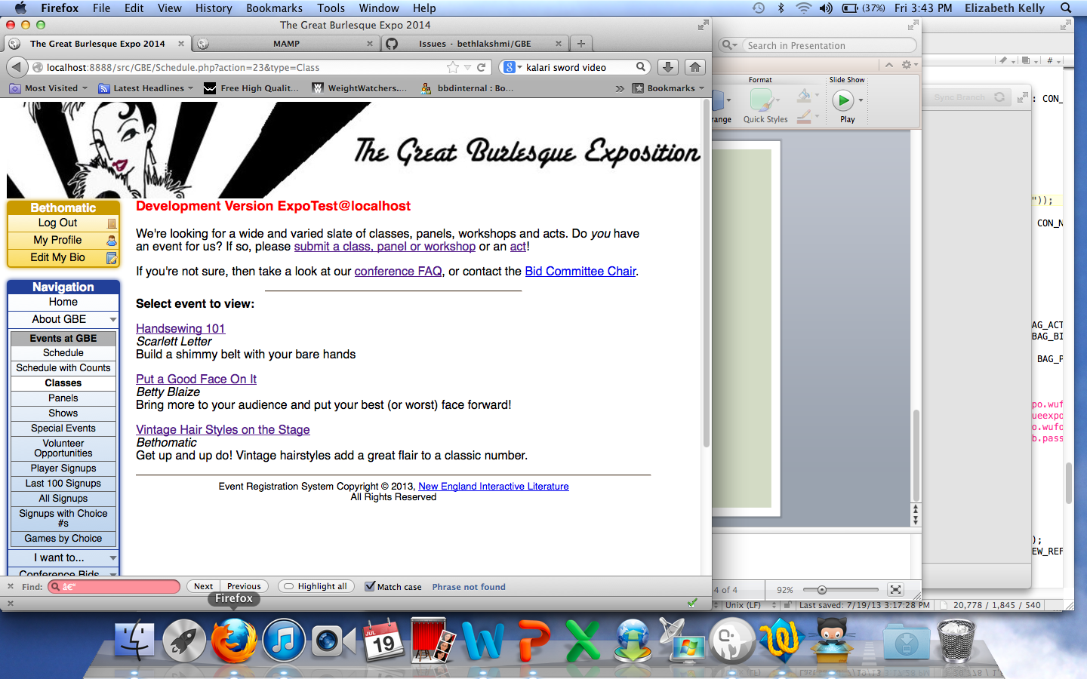
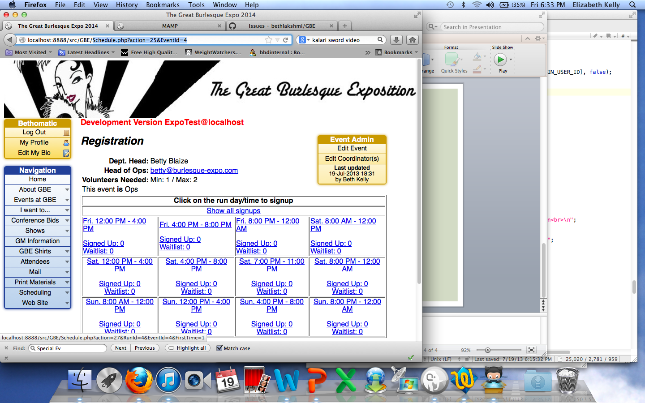
Schedule.php
Schedule.php?action=34
Schedule.php?action=23&type=Class
Schedule.php?action=23&type=Panel
Schedule.php?action=25&EventId=4
Schedule.php?action=23&type=Show
Schedule.php?action=23&type=Special

Slide 5
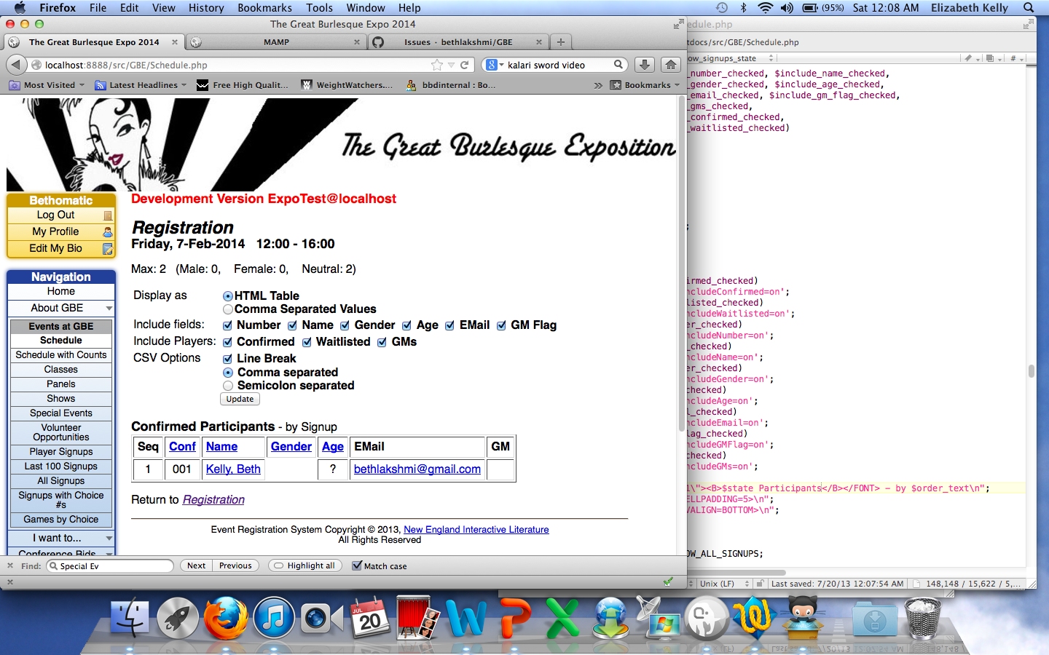
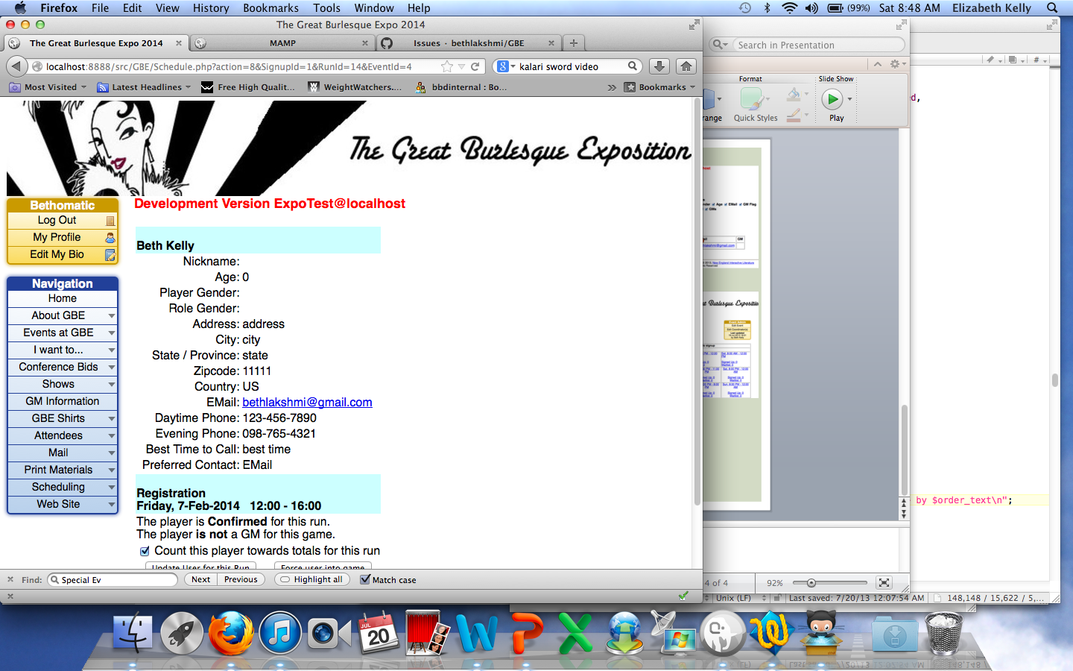
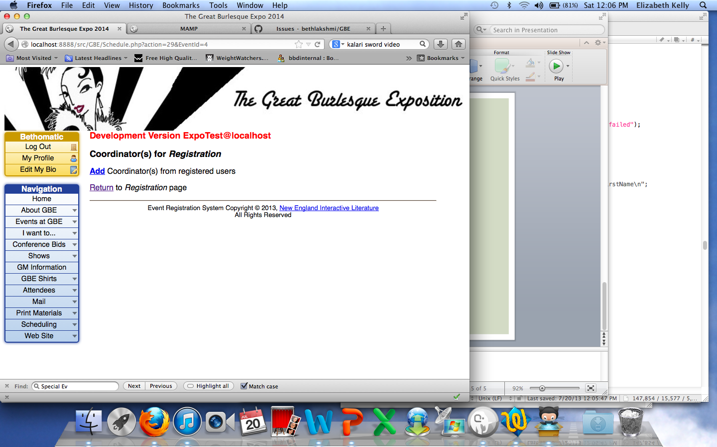
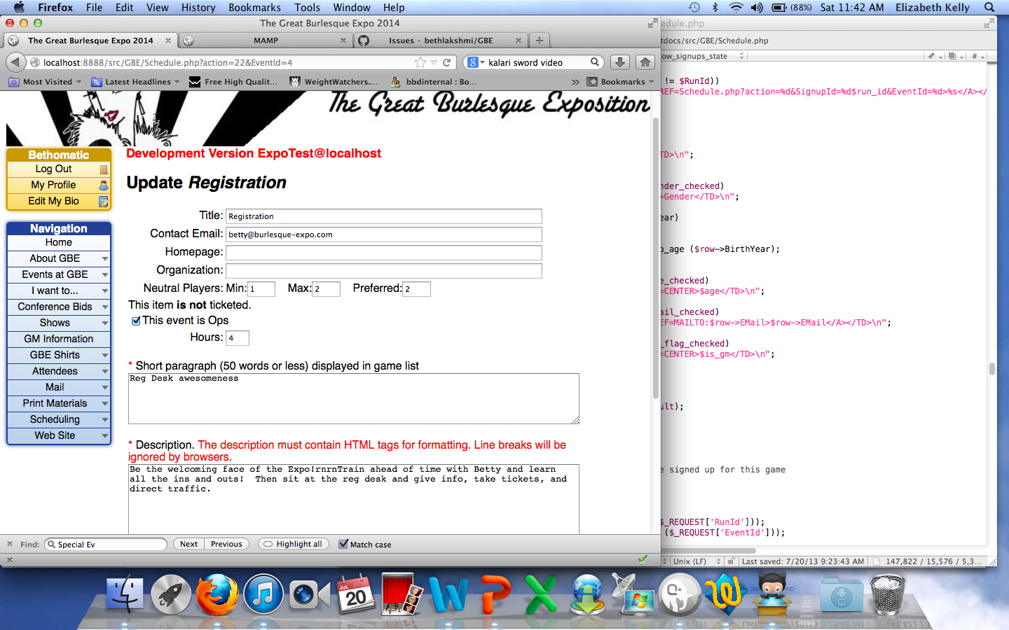
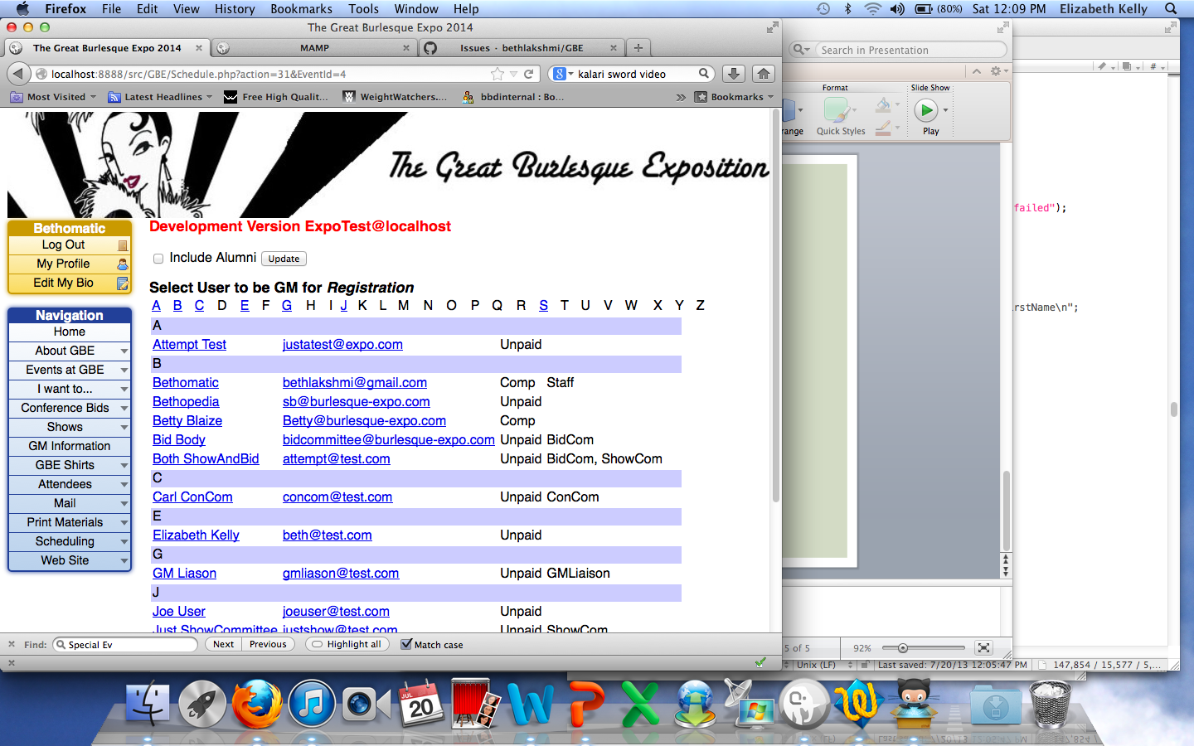
Schedule.php
Schedule.php?action=8&SignupId=1 &RunId=14&EventId=4
Schedule.php?action=32&
EventId=4&Seq=<int>&UserId=<int>
Schedule.php?action=29&
EventId=4
Schedule.php?action=25&EventId=4
Schedule.php?action=22&EventId=4

Slide 6
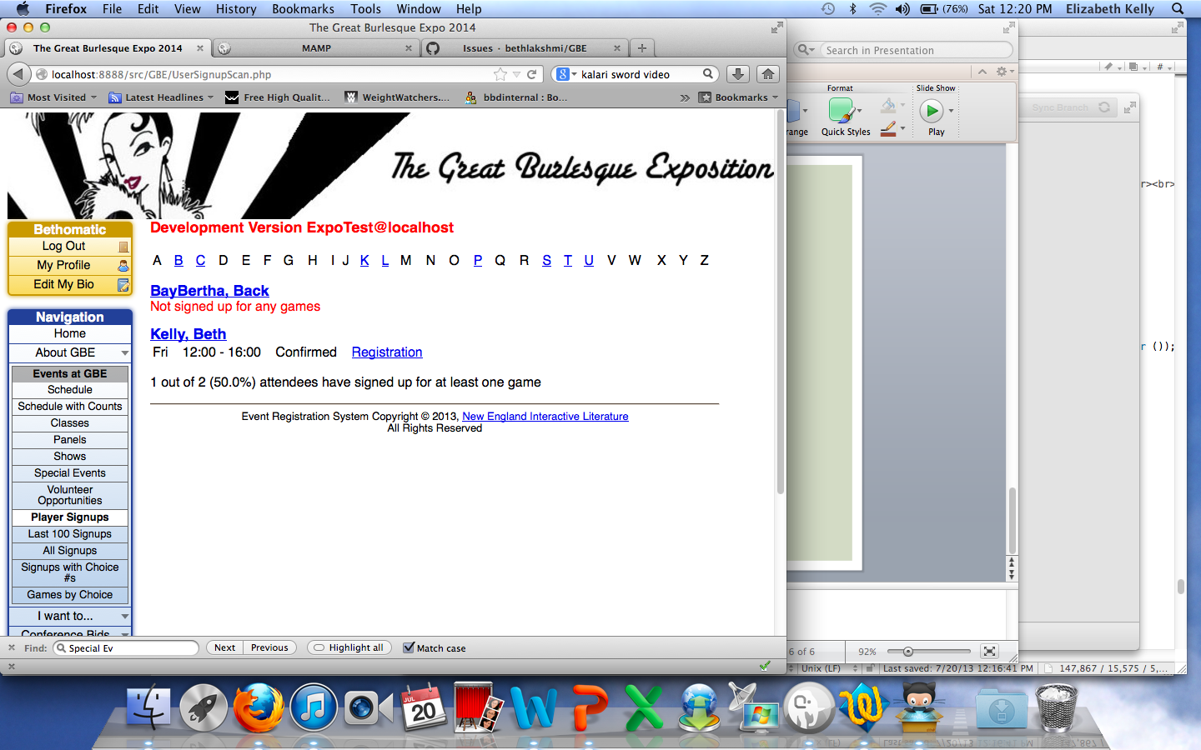
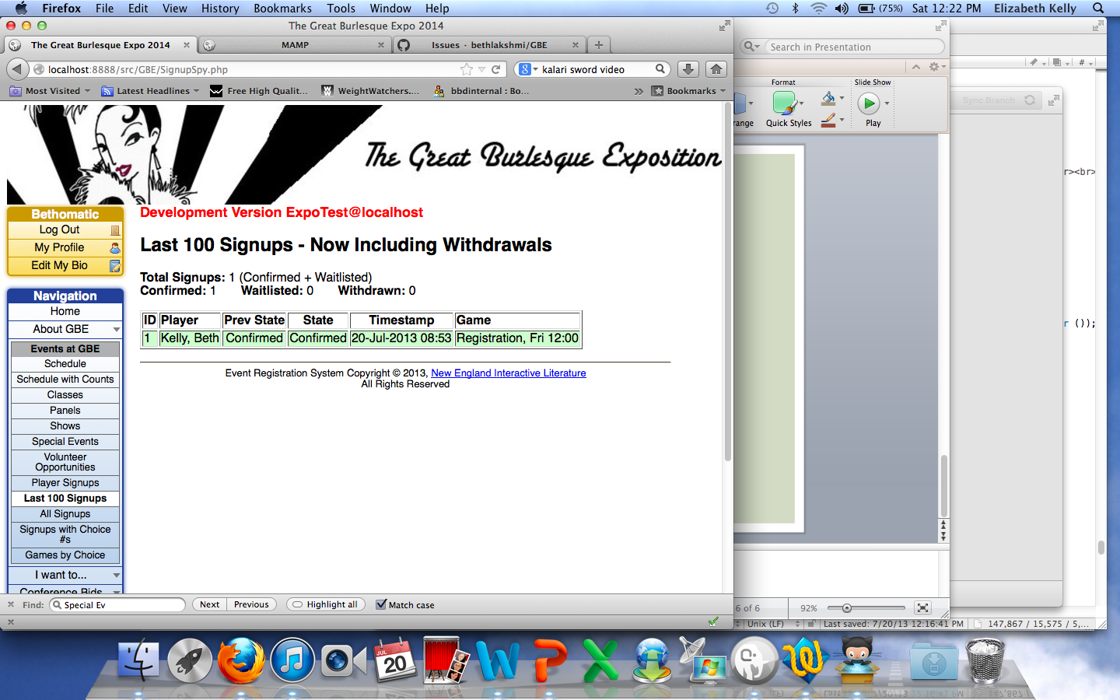
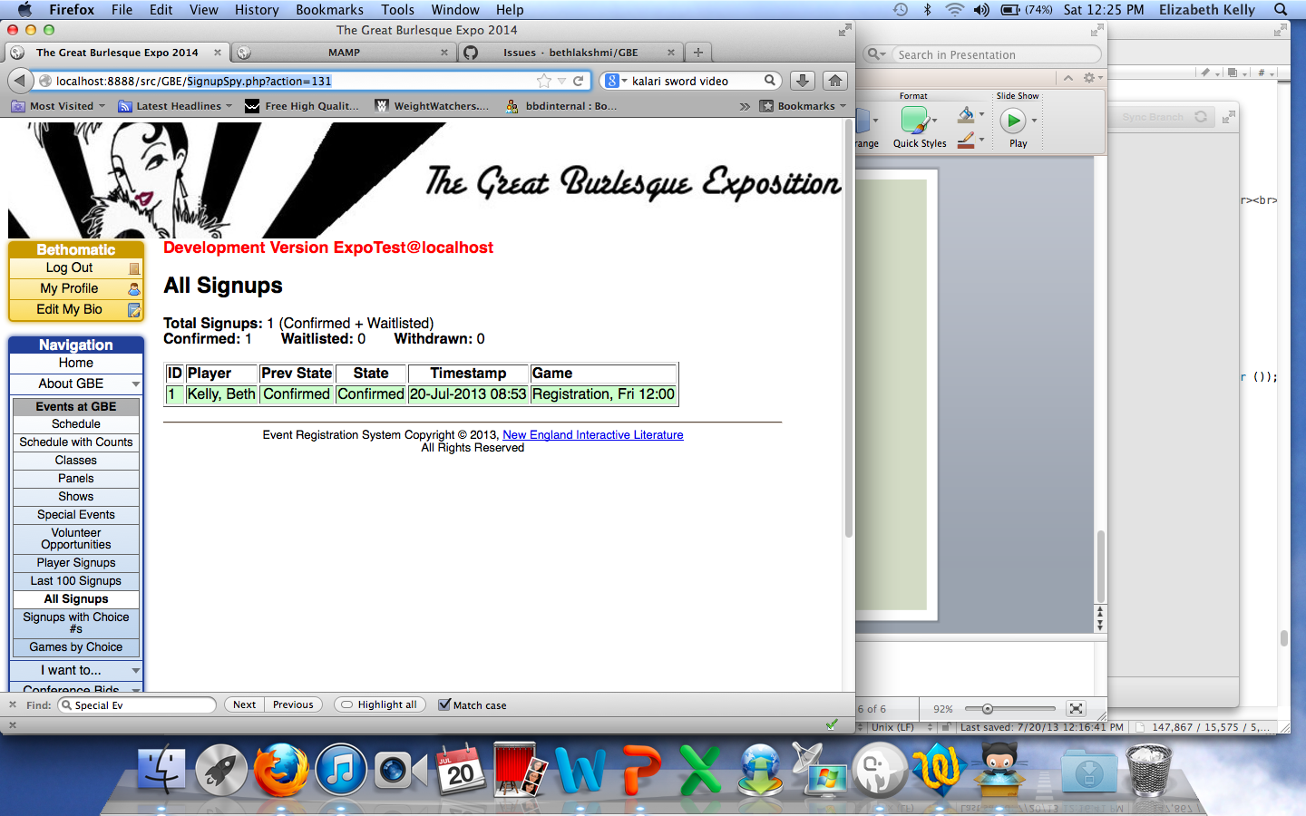
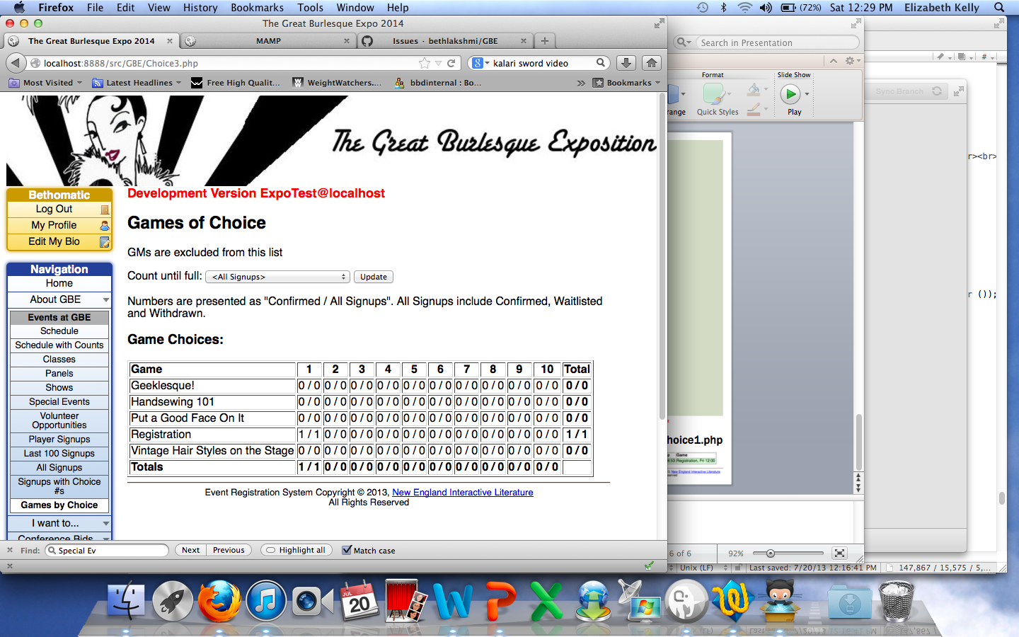
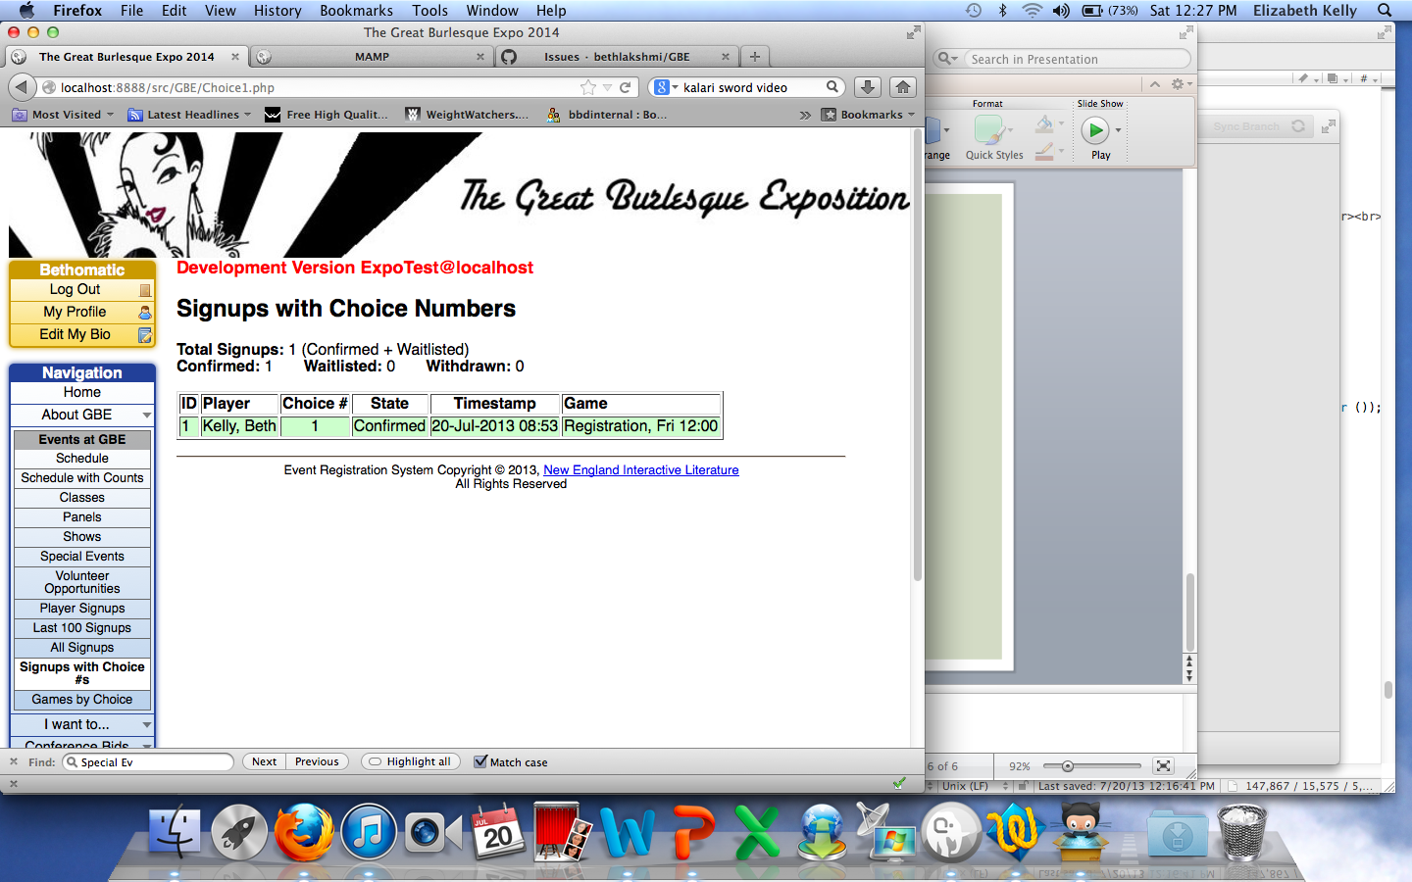
Needs complete rehab – this is all about game signup, which is fairly trivial in our world. Recommend:
1 Ops track based diplay
1 Teacher/panelist display of who, when, where, and if they are registered
1 space based display for EVERY location and ALL stuff
1 show based display – per night, who’s in the show, are they registered/ticketed, and when rehearsing
UserSignupScan.php
SignupSpy.php
SignupSpy.php?action=131
Choice3.php
Choice1.php

Slide 7
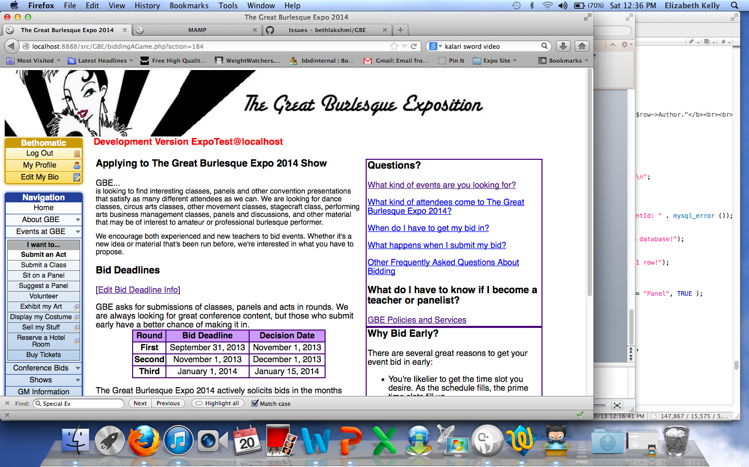
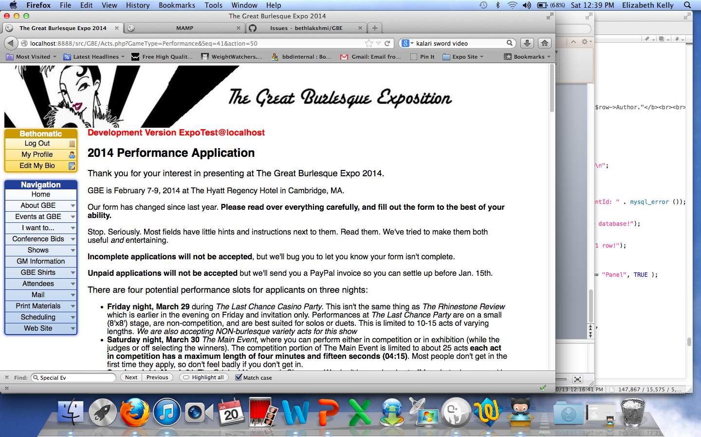
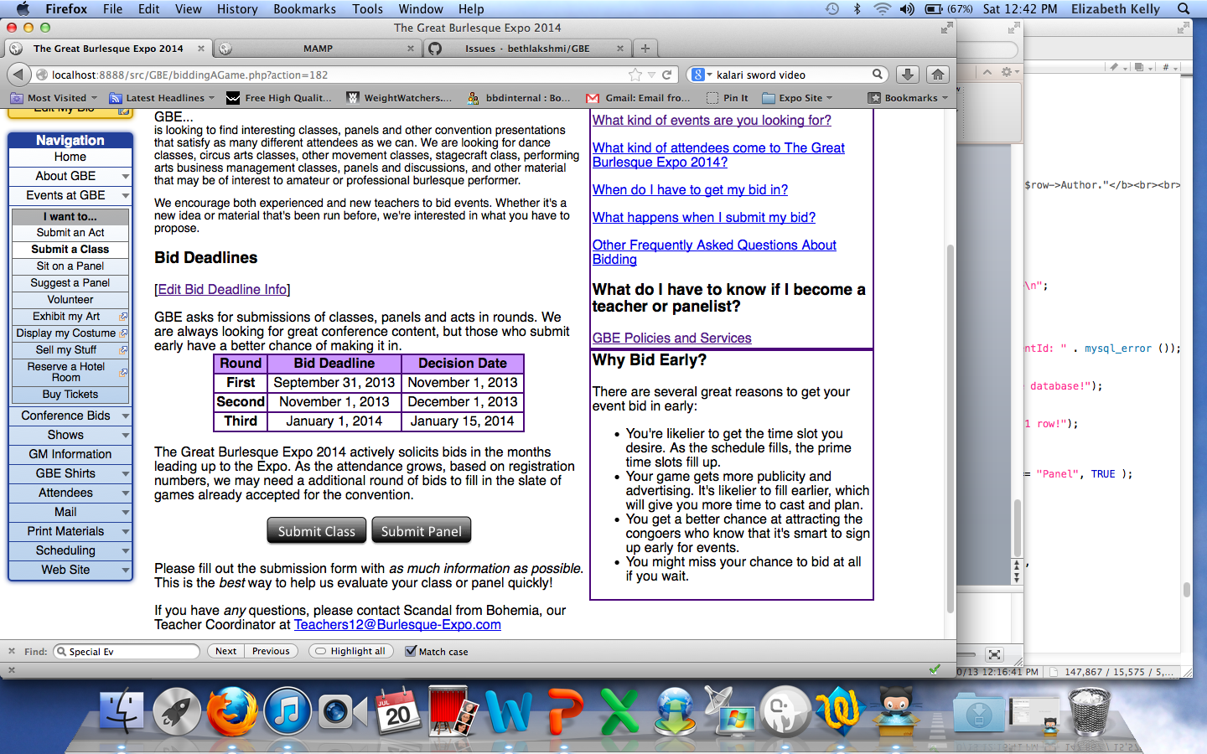
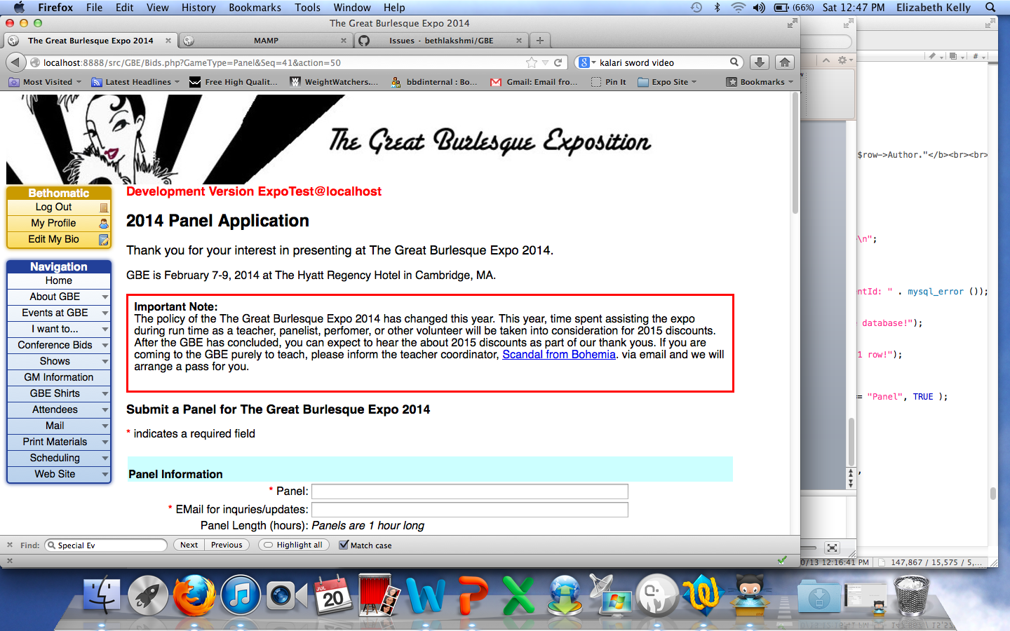
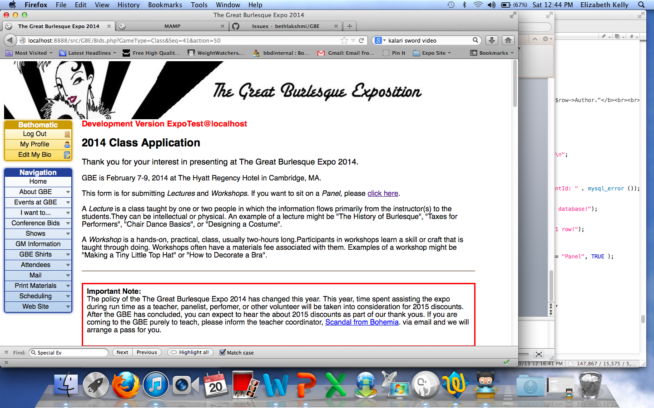
biddingAGame.php?action=184
Acts.php?GameType=Performance&
Seq=41&action=50
Option could be to remove the front material, and add the bid deadline info to each followon page Simpler but with a lot more text on a single page. Helps w navigation.
biddingAGame.php?action=182
Bids.php?GameType=Panel
&Seq=41&action=50
Bids.php?GameType=Class&Seq=41&action=50
All submissions lead to a Thank You – either Bids or Acts

Slide 8
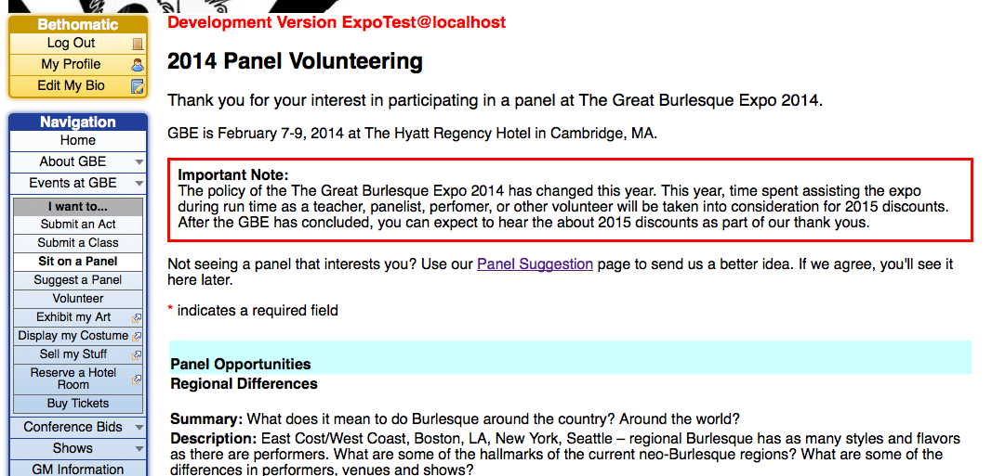
Panels.php
Schedule.php?action=23&type=Ops
https://burlesqueexpo.wufoo.com/forms/art-show-submission/
https://burlesqueexpo.wufoo.com/forms/2013-costume-submission/
https://burlesqueexpo.wufoo.com/forms/2013-vendor-application-form/
https://resweb.passkey.com/go/e7faff68
Static.php?page=comingsoon

Slide 9
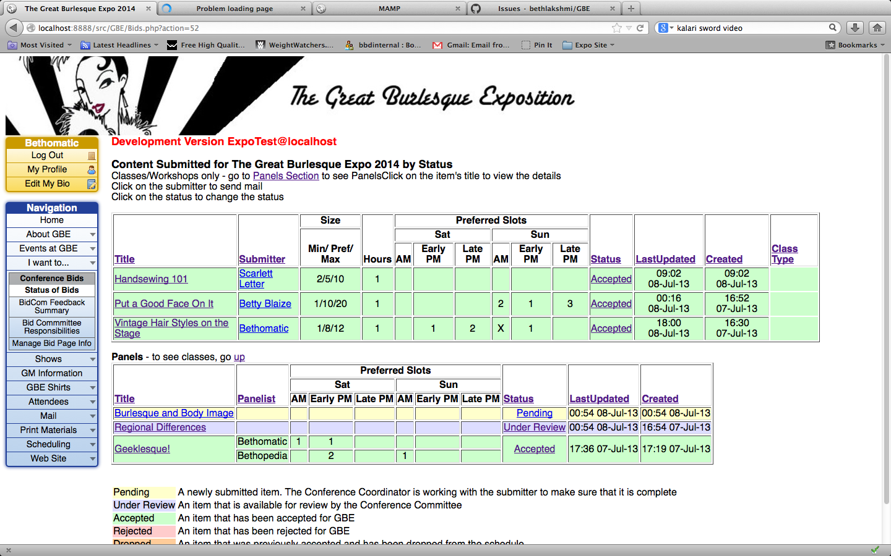
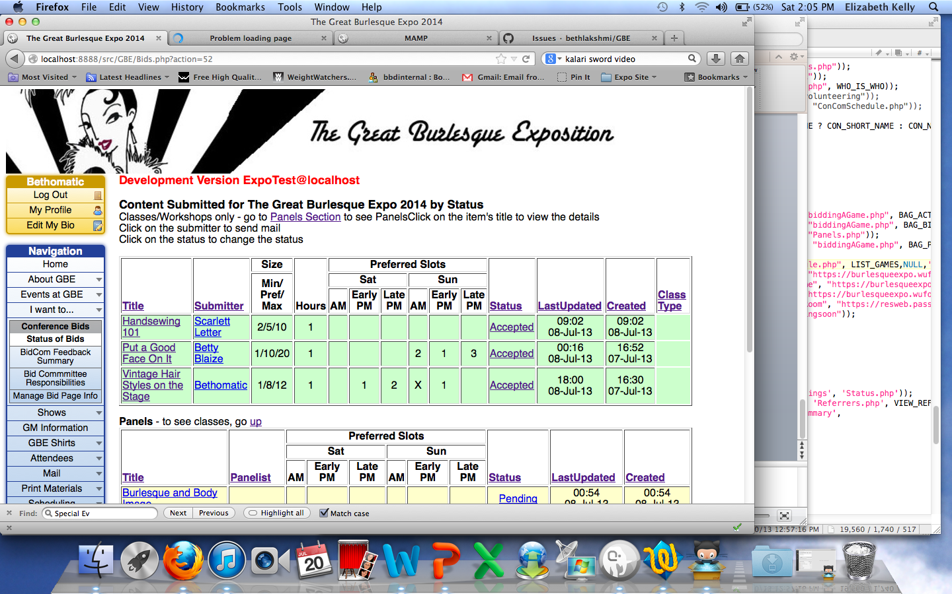
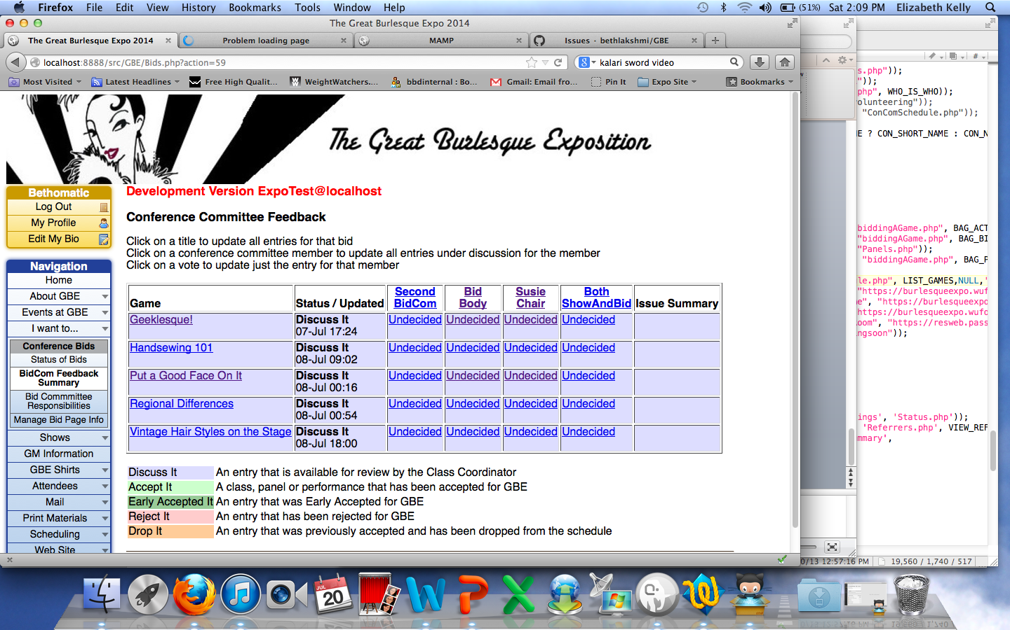
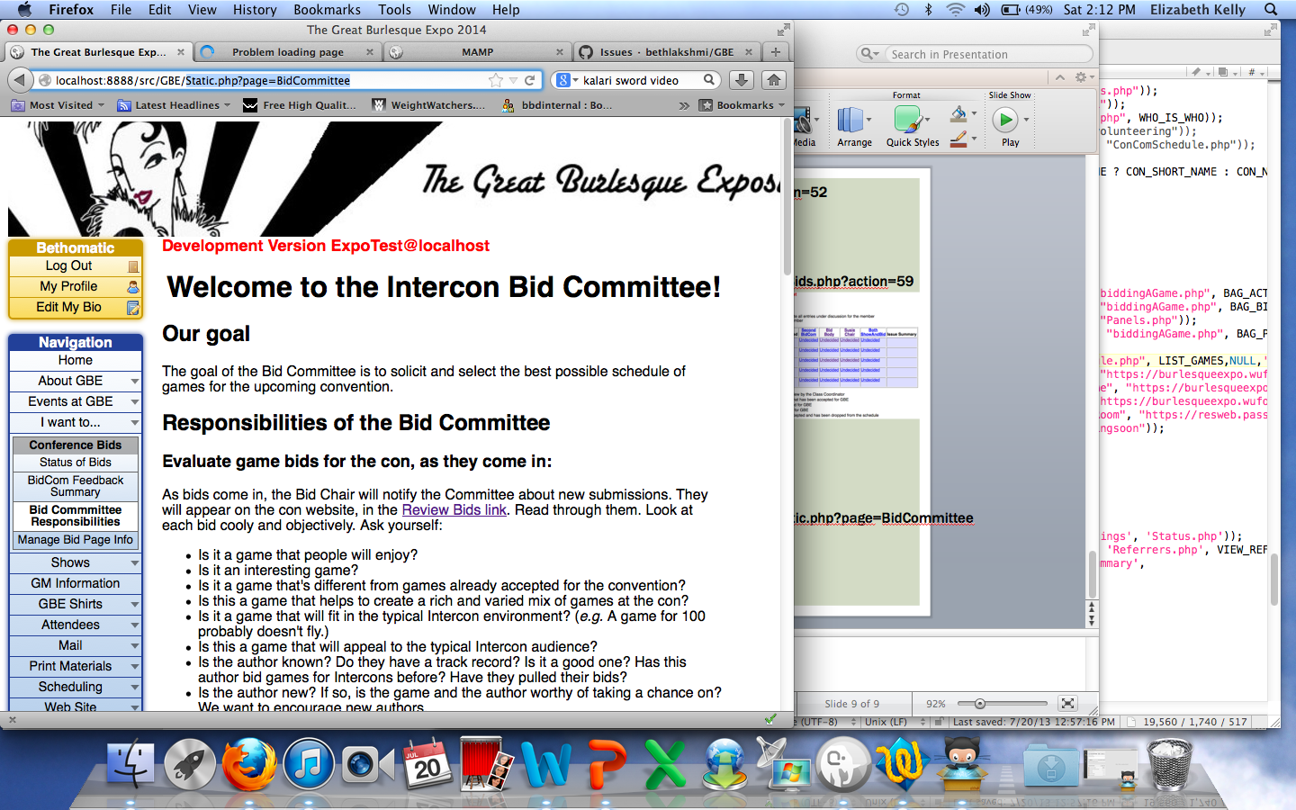
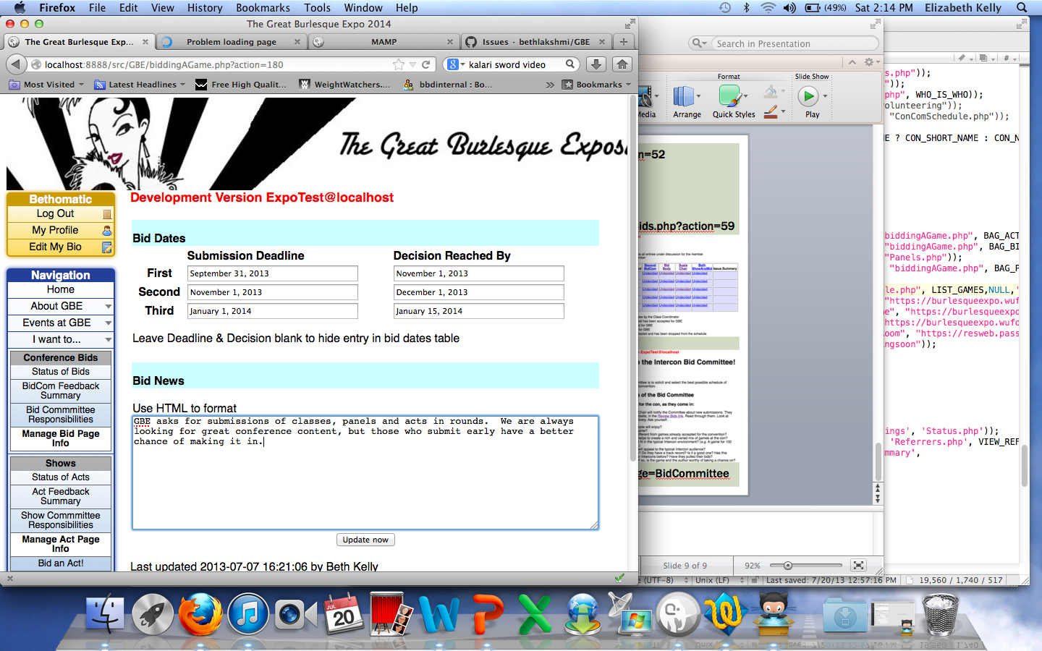
Bids.php?action=52
Bids.php?action=59
biddingAGame.php?action=180
Static.php?page=BidCommittee

Slide 10
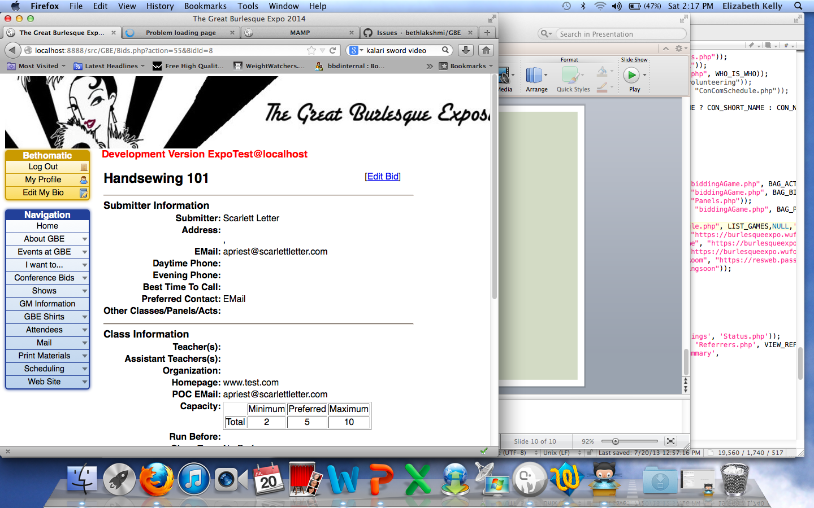
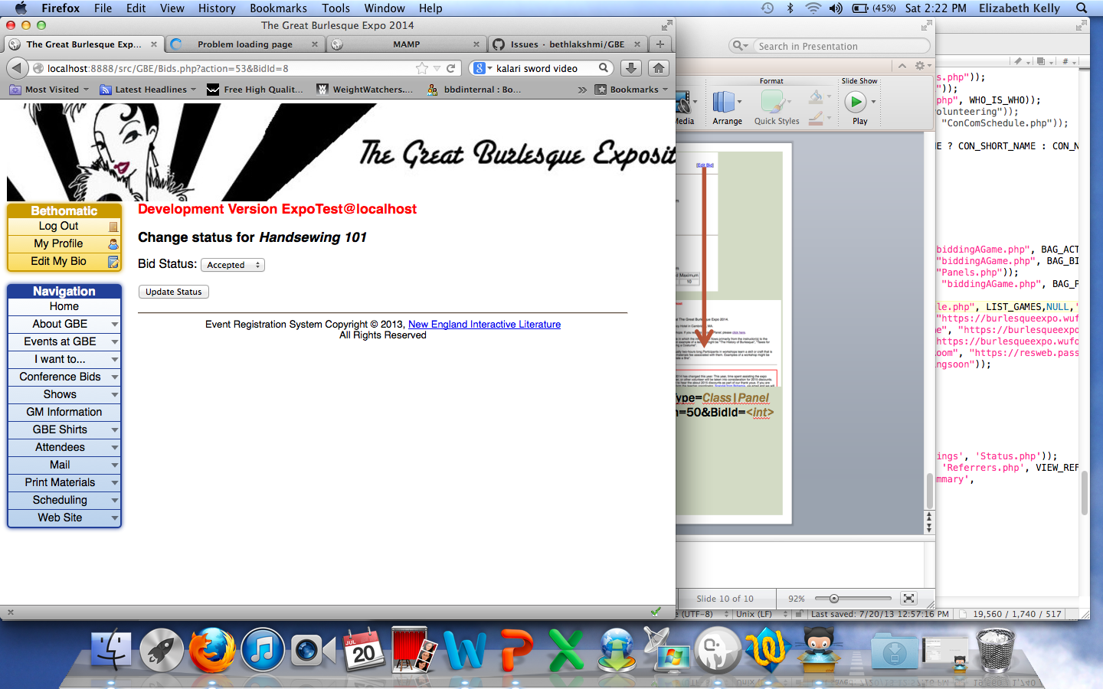
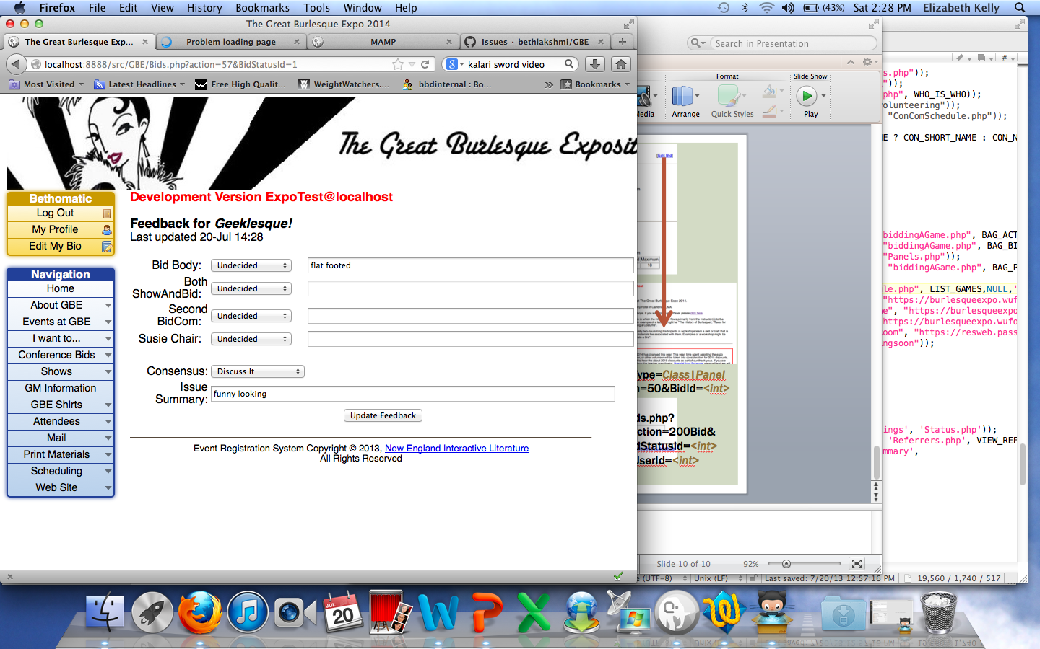
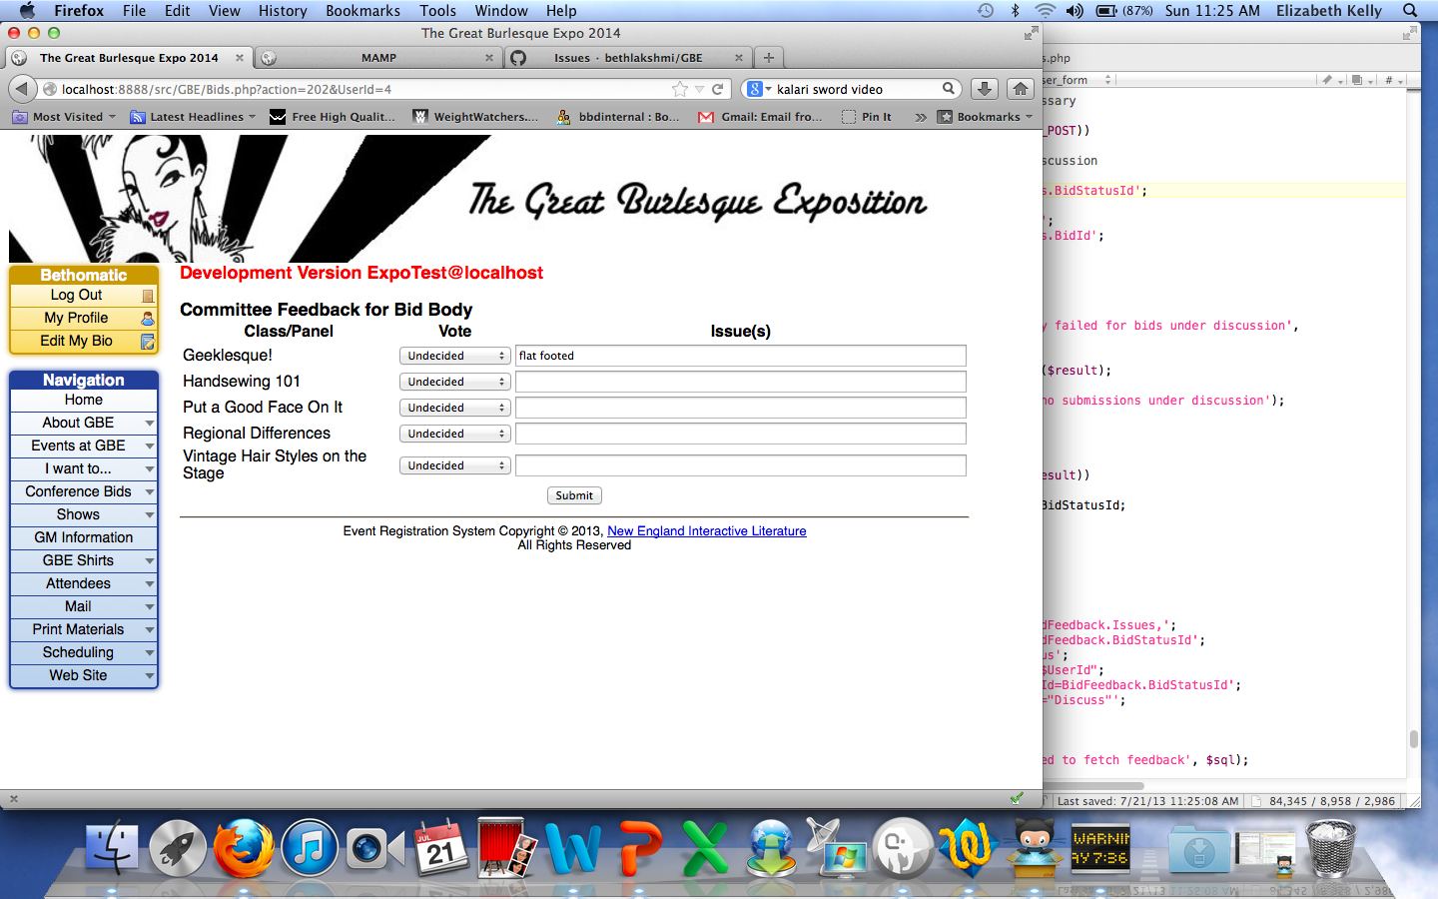

Bids.php?
action=55
&BidId=<int>
Bids.php?action=52
Bids.php?action=53
&BidId=<int>
Bids.php?action=57
&BidStatusId=<int>
Bids.php?action=202&
UserId=<int>
Bids.php?GameType=Class|Panel
&Seq=41&action=50&BidId=<int>
Bids.php?action=59
Bids.php?aaction=200Bid&
BidStatusId=<int>
&UserId=<int>

Slide 11
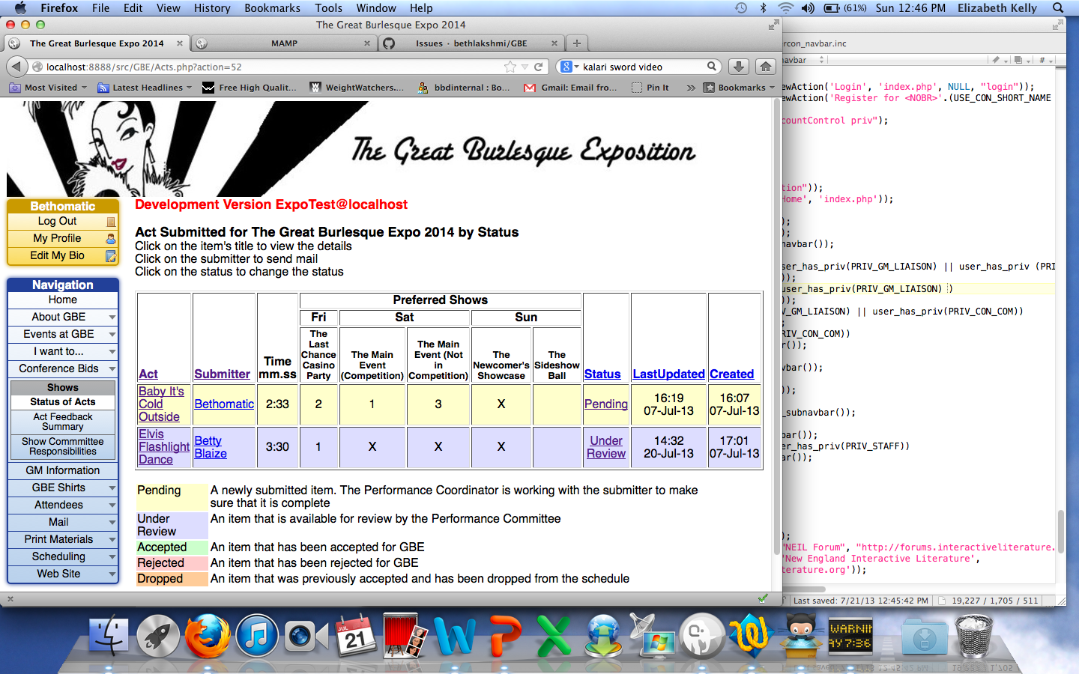
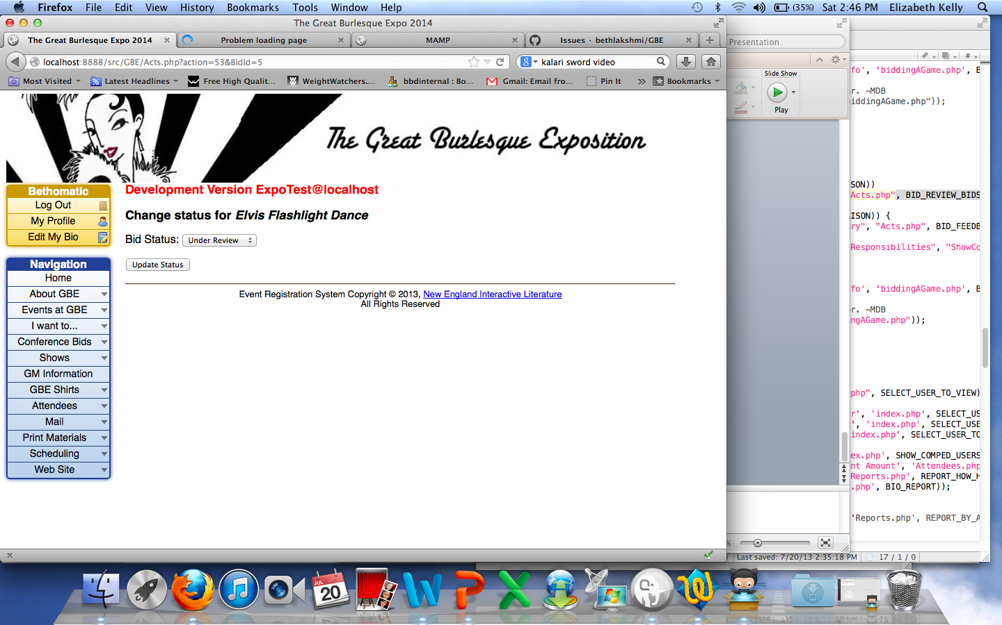
Acts.php?action=52
Acts.php?action=55
&BidId=<int>
Acts.php?action=53&BidId=<int>
Acts.php?GameType=Performance&
Seq=41&action=50&BidId=<int>

Slide 12
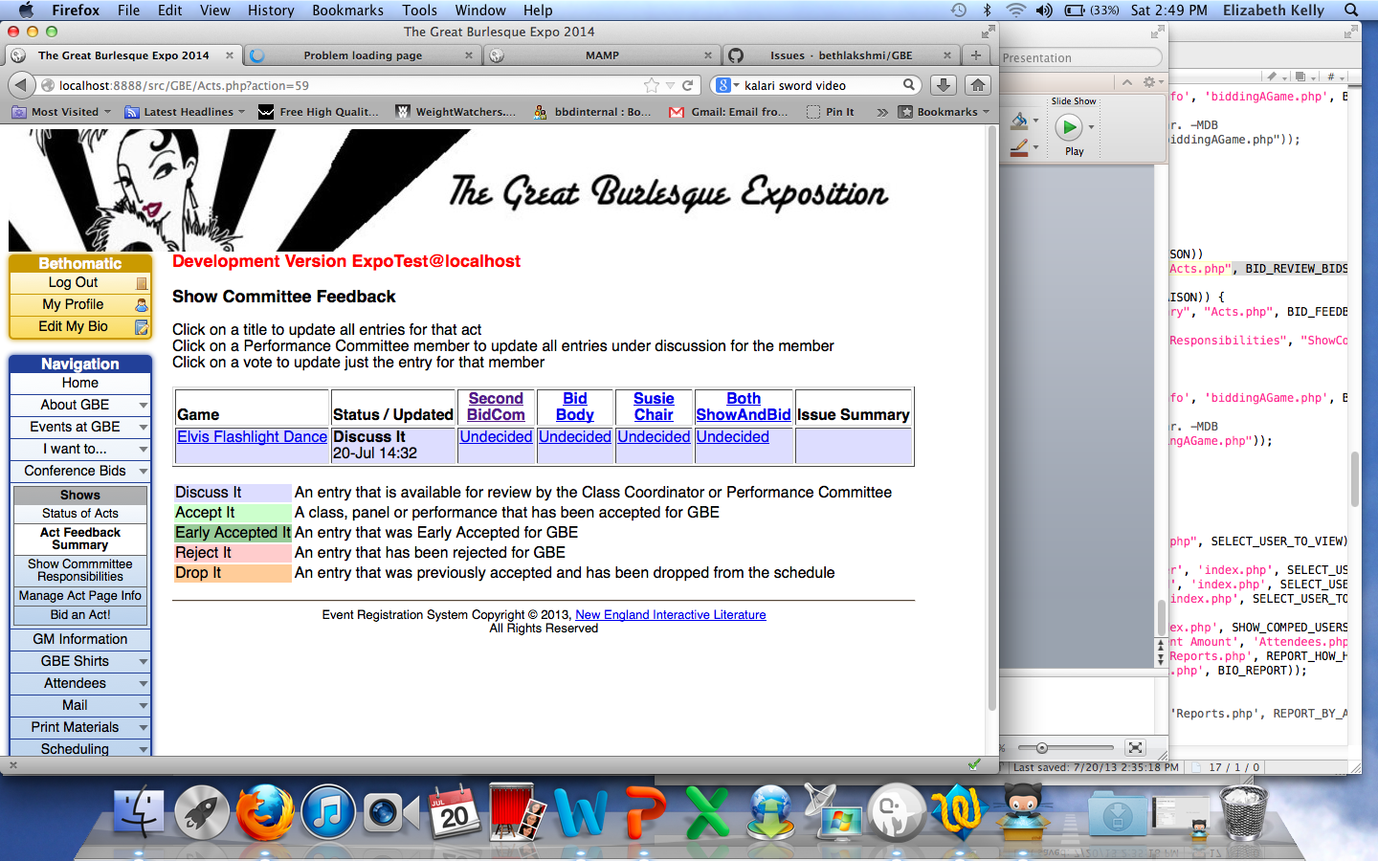
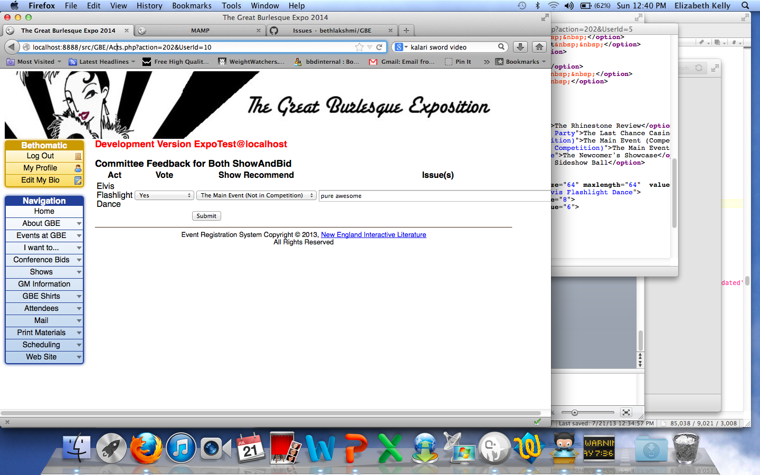
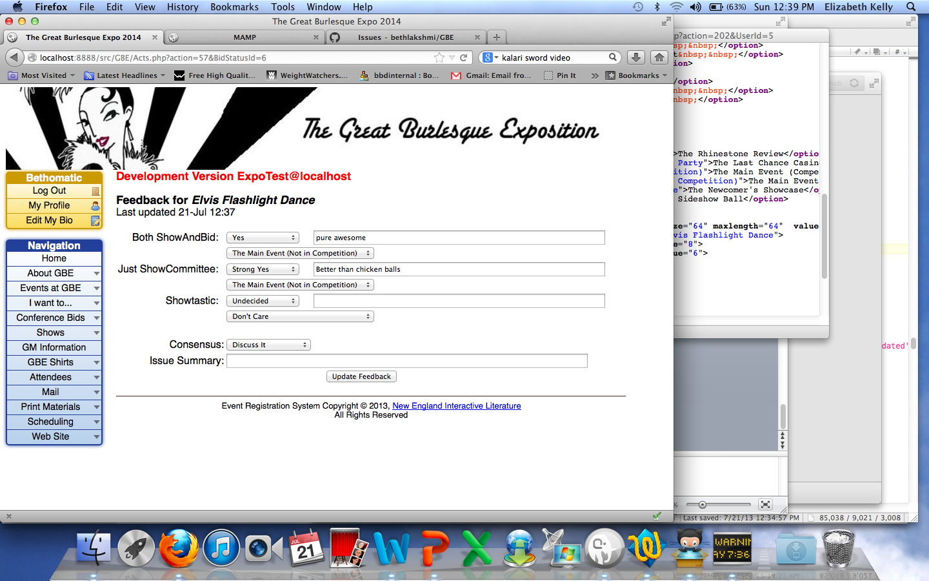
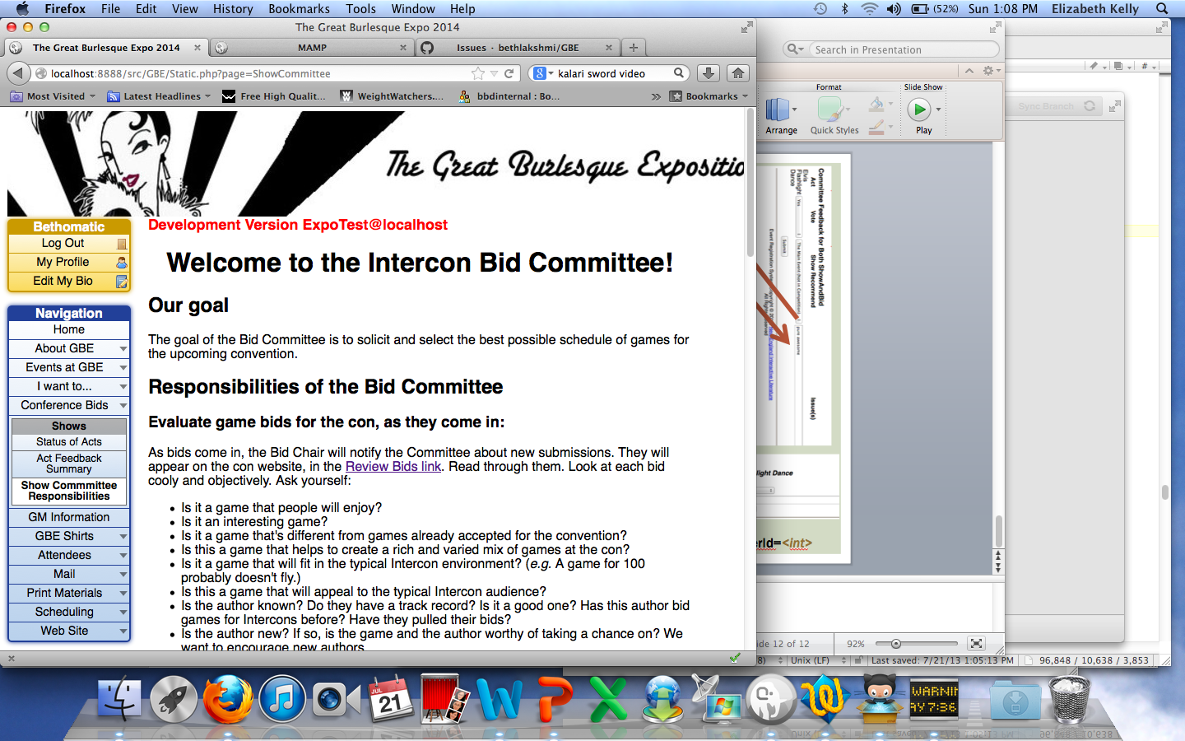
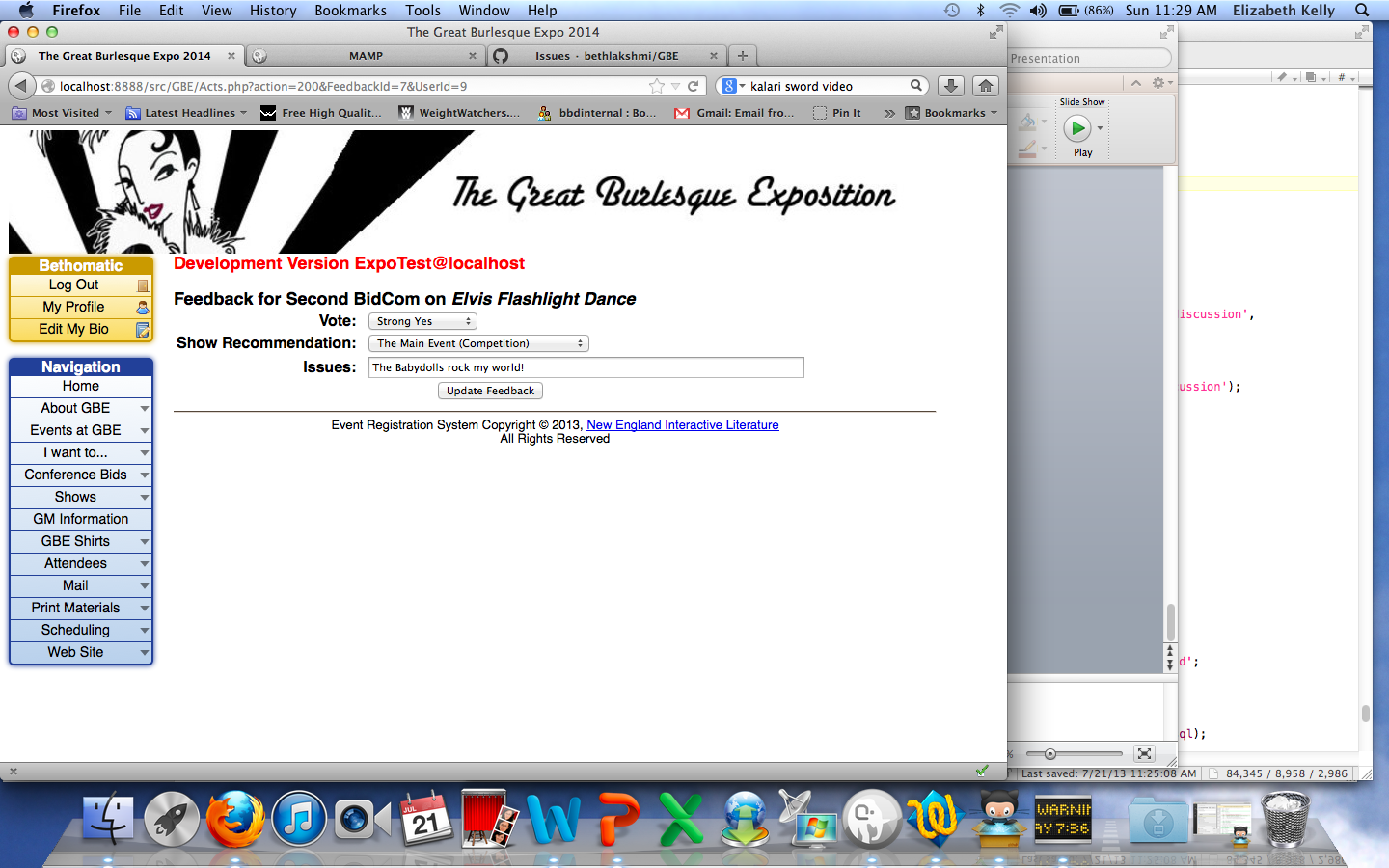
Acts.php?action=57&
BidStatusId=<int>
Static.php?page=ShowCommittee
Acts.php?action=200&
FeedbackId=<int>&UserId=<int>

Slide 13




Static.php?page=GMPoliciesStatic.php?page=GMPolicies
TShirts.php
TShirts.php?action=123
TShirts.php?action=122

Slide 14





index.php?action=82&
Seq=108&UserId=<int>
index.php?action=81
index.php?action=13
index.php?action=14&Seq=120&UserId=<int>

Slide 15






index.php?action=141&
Seq=132&UserId=<int>
index.php
index.php?action=140
index.php?action=19
&UserId=<int>
index.php?action=18
index.php

Slide 16





index.php?action=17
Will need to change content
Reports.php?action=109
Attendees.php
index.php?action=143
index.php?action=86
Home page for new user

Slide 17






MailTo.php?action=73
MailTo.php?action=72
MailTo.php?action=76
MailTo.php?
action=74
MailTo.php?action=75

Slide 18



MailTo.php?
action=72
Reports.php
Reports.php

Slide 20




ListGames.php
ListGames.php?
action=61&
EventId=<int>
OR
ListGames.php?
action=63&
RunId=<int>
ListGames.php?action=69
ListGames.php?action=70

Slide 21


SpecialEvents.php
SpecialEvents.php?action=42

Slide 22



Expect post-ticket system update
Change here.
Status.php
Referrers.php?
action=110
Referrers.php?
action=111

